Slide 1
OASIS User Training for Certification Bodies
Part 1 – Public Section
July, 2013

Slide 2
OASIS User Training for Certification Bodies
Part 1 - Public Section
Training Content:
Overview
New Users
Login for Registered Users
The Main Screen
Change Summary
My Watch List
My Email Notification
Feedback – General
Feedback - Path 1
Feedback – Path 2
General Information Searches
IAQG Member Companies
National Aerospace Industry Associations
National Accreditation Bodies (NABs)
Certification Bodies (CBs)
Auditor Authentication Bodies (AABs)
Auditors (AEA/non-AEA)
Training Provider Approval Bodies (TPAB)
Approved Training Providers (ATP)
Certified Suppliers Directory
Help and Information

Slide 3
OASIS User Training for Certification Bodies
Overview:
Background
OASIS contains two primary sections
Data Search (Public) Section
Applications (User group-specific) Section
OASIS uses English as its main language.
Written skills associated with that language are essential.
Scope of Training
This training is designed to provide detailed guidance for Certification
Body (CB) personnel who will be entering data into OASIS
Part 1 covers Public Section functions
Part 2 covers Applications for the CB user group.

Slide 4
OASIS User Training for Certification Bodies
Part 1 - Public Section
Training Content:
Overview✓
New Users
Login for Registered Users
The Main Screen
Change Summary
My Watch List
My Email Notification
Feedback – General
Feedback - Path 1
Feedback – Path 2
General Information Searches
IAQG Member Companies
National Aerospace Industry Associations
National Accreditation Bodies (NABs)
Certification Bodies (CBs)
Auditor Authentication Bodies (AABs)
Auditors (AEA/non-AEA)
Training Provider Approval Bodies (TPAB)
Approved Training Providers (ATP)
Certified Suppliers Directory
Help and Information

Slide 5
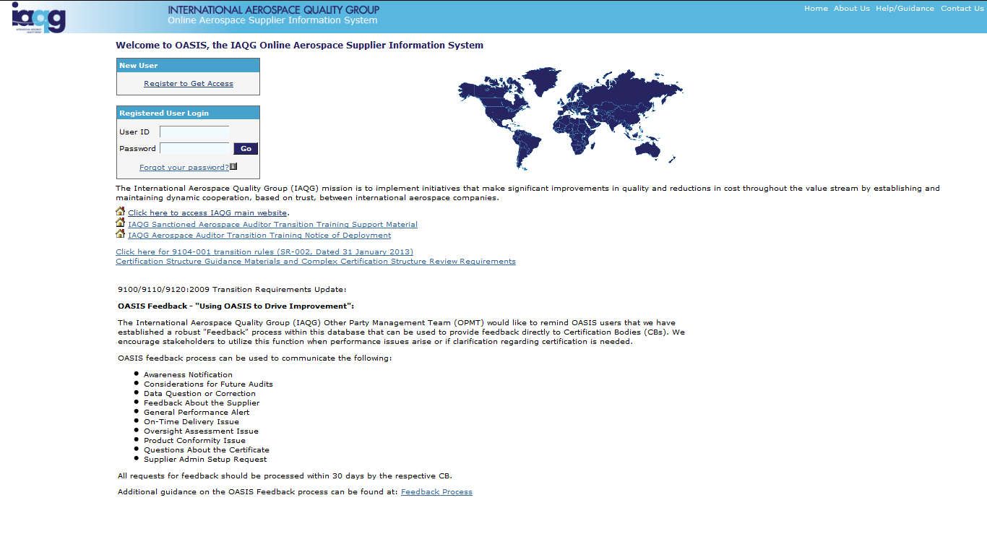
OASIS Public Section
New Users
Click here
to
Register
http://www.iaqg.org/oasis

Slide 6
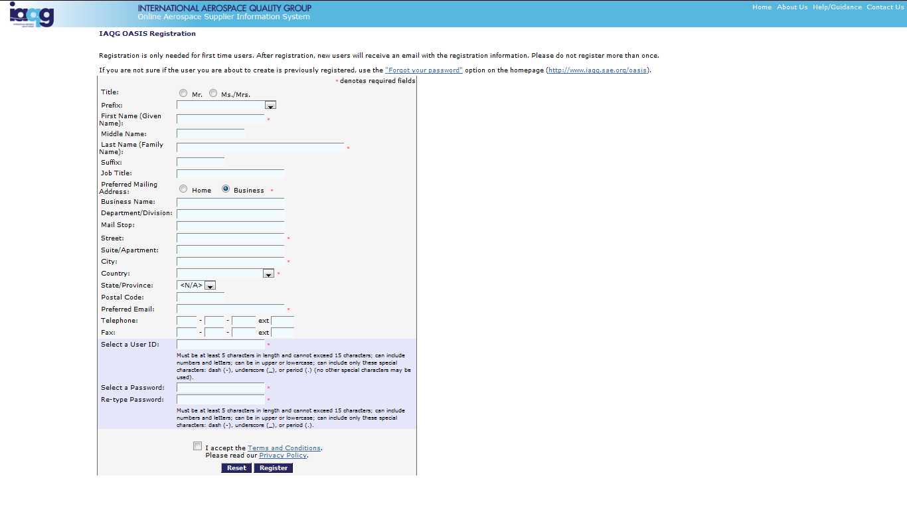
OASIS Public Section
New Users
Complete all details, accept
Terms and Conditions,
and click to Register

Slide 7
OASIS User Training for Certification Bodies
Part 1 - Public Section
Training Content:
Overview✓
New Users✓
Login for Registered Users
The Main Screen
Change Summary
My Watch List
My Email Notification
Feedback – General
Feedback - Path 1
Feedback – Path 2
General Information Searches
IAQG Member Companies
National Aerospace Industry Associations
National Accreditation Bodies (NABs)
Certification Bodies (CBs)
Auditor Authentication Bodies (AABs)
Auditors (AEA/non-AEA)
Training Provider Approval Bodies (TPAB)
Approved Training Providers (ATP)
Certified Suppliers Directory
Help and Information

Slide 8
OASIS Public Section
Login for Registered Users
Help and
Guidance
Enter Details
And “Go”
Highlighted
Information
Use to check passwords
and multiple registrations

Slide 9
OASIS User Training for Certification Bodies
Part 1 - Public Section
Training Content:
Overview✓
New Users✓
Login for Registered Users✓
The Main Screen
Change Summary
My Watch List
My Email Notification
Feedback – General
Feedback - Path 1
Feedback – Path 2
General Information Searches
IAQG Member Companies
National Aerospace Industry Associations
National Accreditation Bodies (NABs)
Certification Bodies (CBs)
Auditor Authentication Bodies (AABs)
Auditors (AEA/non-AEA)
Training Provider Approval Bodies (TPAB)
Approved Training Providers (ATP)
Certified Suppliers Directory
Help and Information

Slide 10
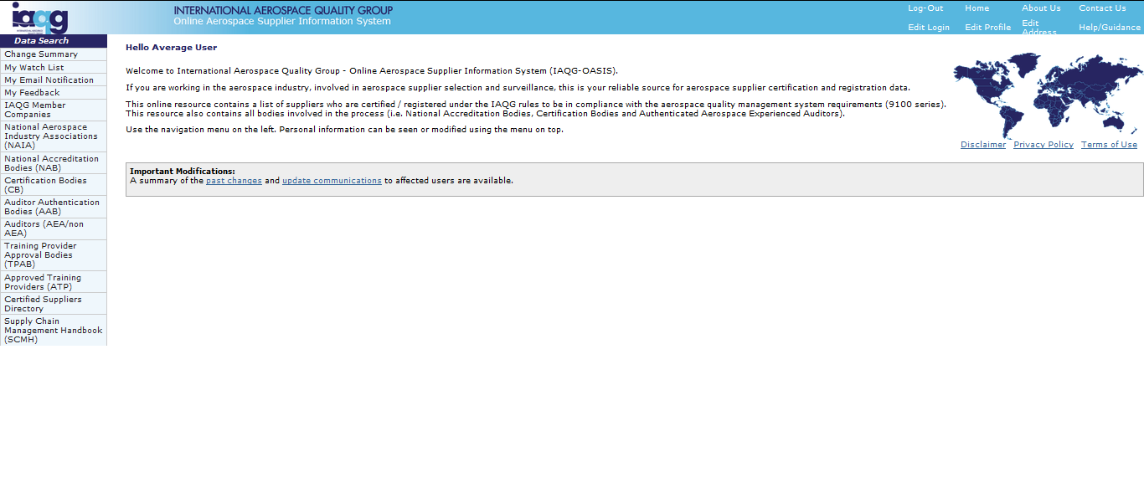
OASIS Public Section
The Main Screen – Individual User Functions

Slide 11
OASIS User Training for Certification Bodies
Part 1 - Public Section
Training Content:
Overview✓
New Users✓
Login for Registered Users✓
The Main Screen✓
Change Summary
My Watch List
My Email Notification
Feedback – General
Feedback - Path 1
Feedback – Path 2
General Information Searches
IAQG Member Companies
National Aerospace Industry Associations
National Accreditation Bodies (NABs)
Certification Bodies (CBs)
Auditor Authentication Bodies (AABs)
Auditors (AEA/non-AEA)
Training Provider Approval Bodies (TPAB)
Approved Training Providers (ATP)
Certified Suppliers Directory
Help and Information

Slide 12
OASIS Public Section
Change Summary
Click to
Access
View certification/authentication change history associated with Suppliers, NABs/CBs/AABs and Auditors

Slide 13
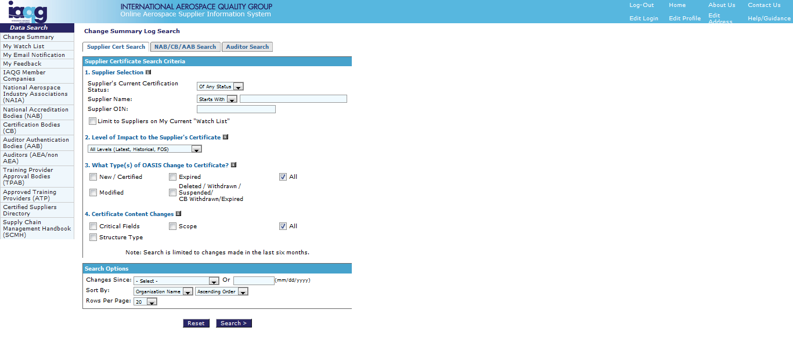
OASIS Public Section
Change Summary
Select user group
for search
6-month change
data available
Search functionality
allows entering all
or part of name

Slide 14
OASIS User Training for Certification Bodies
Part 1 - Public Section
Training Content:
Overview✓
New Users✓
Login for Registered Users✓
The Main Screen✓
Change Summary✓
My Watch List
My Email Notification
Feedback – General
Feedback - Path 1
Feedback – Path 2
General Information Searches
IAQG Member Companies
National Aerospace Industry Associations
National Accreditation Bodies (NABs)
Certification Bodies (CBs)
Auditor Authentication Bodies (AABs)
Auditors (AEA/non-AEA)
Training Provider Approval Bodies (TPAB)
Approved Training Providers (ATP)
Certified Suppliers Directory
Help and Information

Slide 15
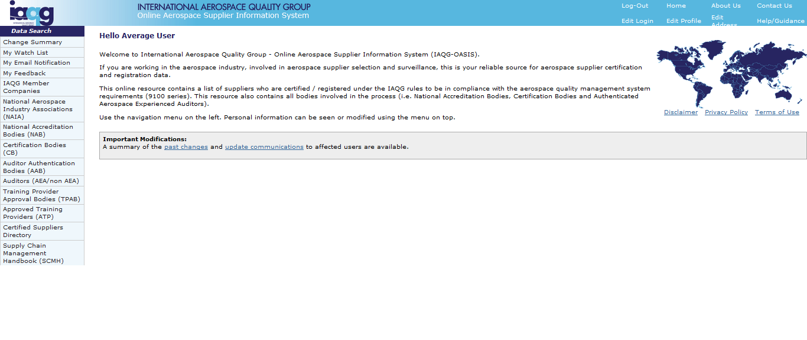
OASIS Public Section
My Watch List
Click to
Access
Create user-specific list of Suppliers, NABs/CBs/AABs and/or Auditors to monitor certification/authentication changes. Use that list to enable receipt of “Email Notification of Changes.”

Slide 16
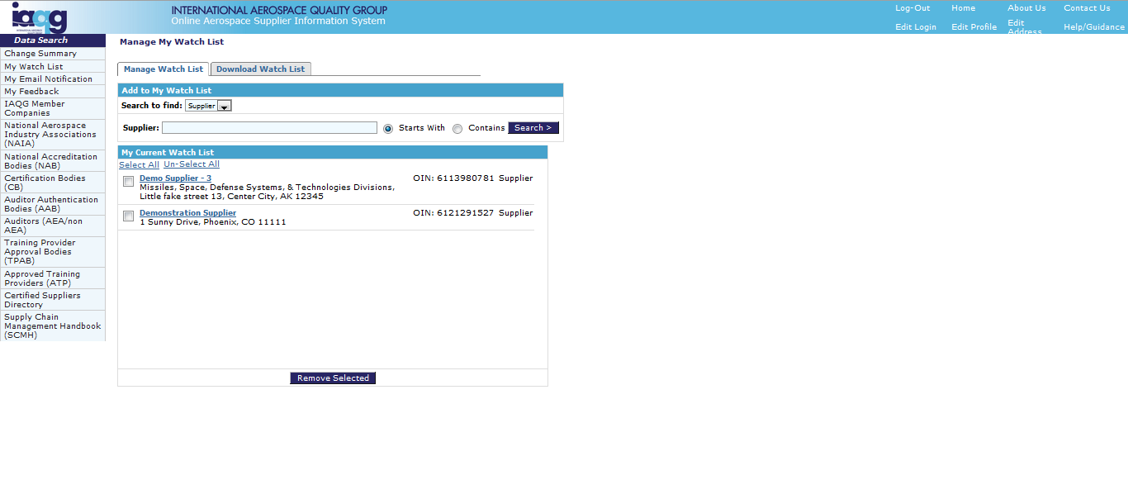
OASIS Public Section
My Watch List
Click to
download
completed
watch list
Click to
search
Enter name or
part of name
Click to
select
user group

Slide 17
OASIS Public Section
My Watch List
Click to view
“Certified Supplier
Directory” entry

Slide 18
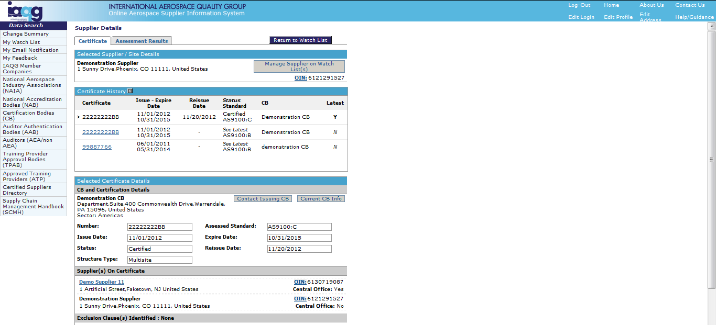
OASIS Public Section
My Watch List
After viewing,
Go back to
“My Watch List”
Click to view
Certificate or
Assessment Results

Slide 19
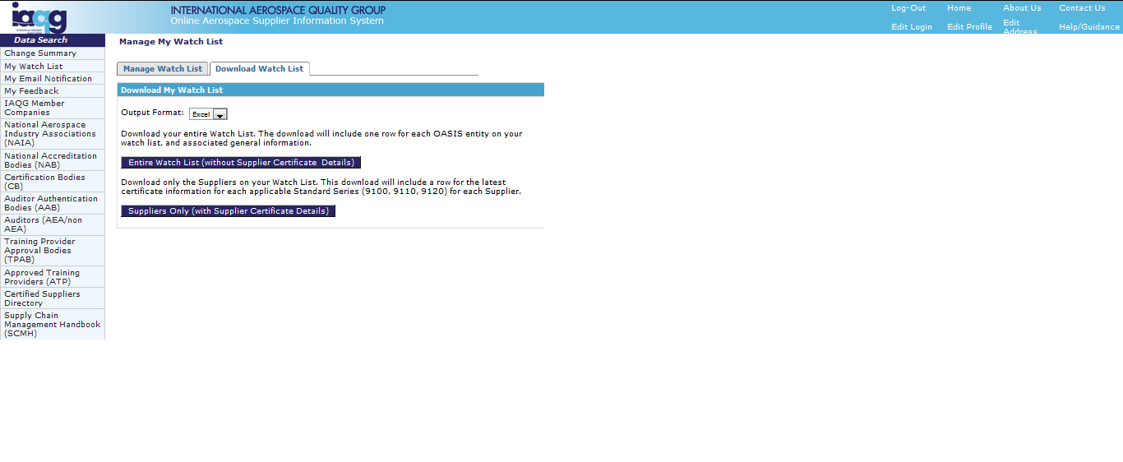
OASIS Public Section
My Watch List
Watch List
download
options

Slide 20
OASIS User Training for Certification Bodies
Part 1 - Public Section
Training Content:
Overview✓
New Users✓
Login for Registered Users✓
The Main Screen✓
Change Summary✓
My Watch List✓
My Email Notification
Feedback – General
Feedback - Path 1
Feedback – Path 2
General Information Searches
IAQG Member Companies
National Aerospace Industry Associations
National Accreditation Bodies (NABs)
Certification Bodies (CBs)
Auditor Authentication Bodies (AABs)
Auditors (AEA/non-AEA)
Training Provider Approval Bodies (TPAB)
Approved Training Providers (ATP)
Certified Suppliers Directory
Help and Information

Slide 21
OASIS Public Section
My Email Notification
Click to
Access

Slide 22
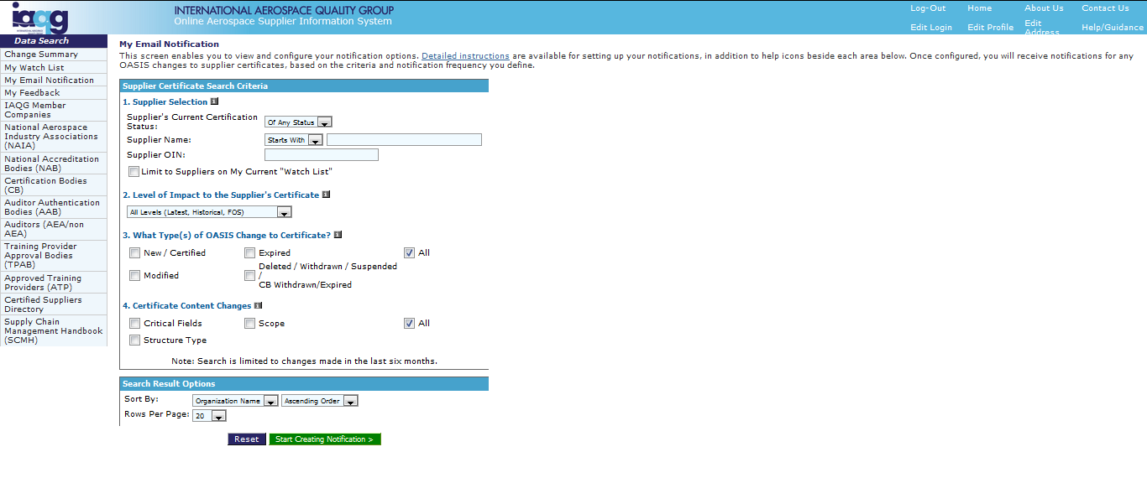
OASIS Public Section
My Email Notification
Access “Detailed
Instructions” for
specific help
Choose
search
parameters
Click to
create
notification

Slide 23
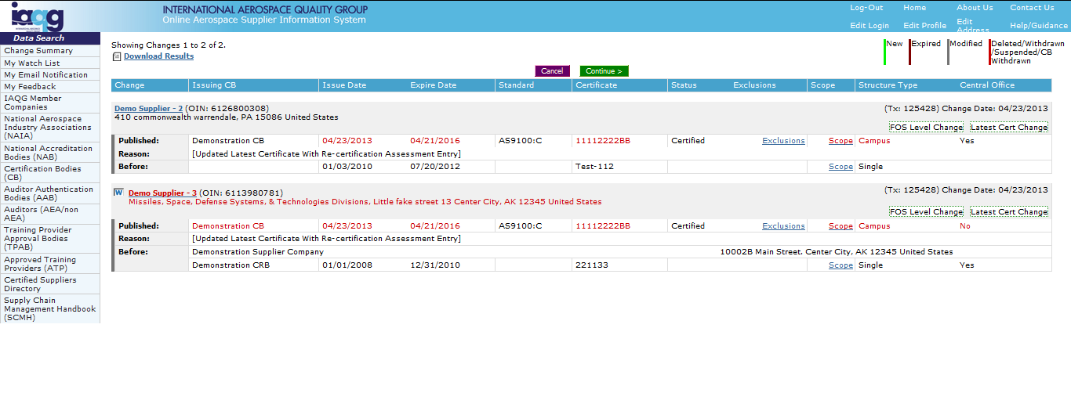
OASIS Public Section
My Email Notification
View
notifications
Click to
continue

Slide 24
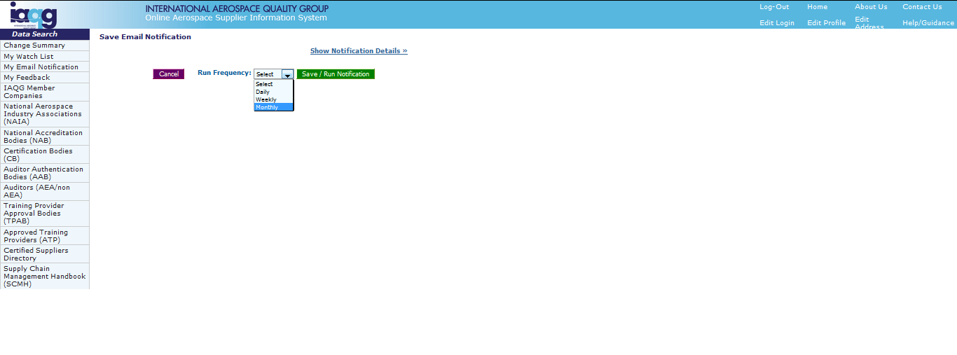
OASIS Public Section
My Email Notification
Choose
run
frequency
Click to
save & run
notification

Slide 25
OASIS User Training for Certification Bodies
Part 1 - Public Section
Training Content:
Overview✓
New Users✓
Login for Registered Users✓
The Main Screen✓
Change Summary✓
My Watch List✓
My Email Notification✓
Feedback – General
Feedback - Path 1
Feedback – Path 2
General Information Searches
IAQG Member Companies
National Aerospace Industry Associations
National Accreditation Bodies (NABs)
Certification Bodies (CBs)
Auditor Authentication Bodies (AABs)
Auditors (AEA/non-AEA)
Training Provider Approval Bodies (TPAB)
Approved Training Providers (ATP)
Certified Suppliers Directory
Help and Information

Slide 26
OASIS Public Section
Feedback - General
Feedback Path 1:
Click to Access
Feedback Path 2:
Click to Access
Two Feedback paths are available. Options differ
depending on the path chosen.

Slide 27
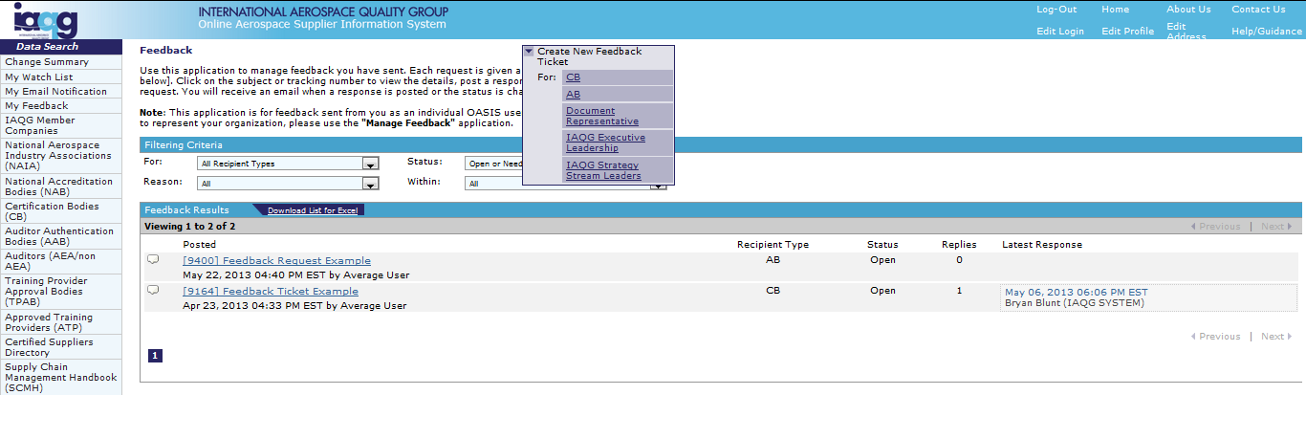
OASIS Public Section
Feedback – Path 1
Click to create
new feedback
request
View your list
of feedback
requests
View all or
filter by
recipient type

Slide 28
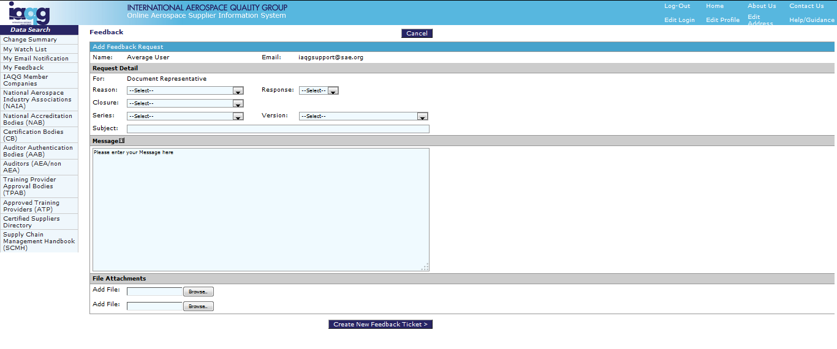
OASIS Public Section
Feedback – Path 1
Select request
details
Choose whether
response is required
Choose whether
closure is delegated
Enter Subject and
message text
Click to send request
Add up to two
attachment files
Feedback is received by recipient personnel with “Manage Feedback” privileges

Slide 29
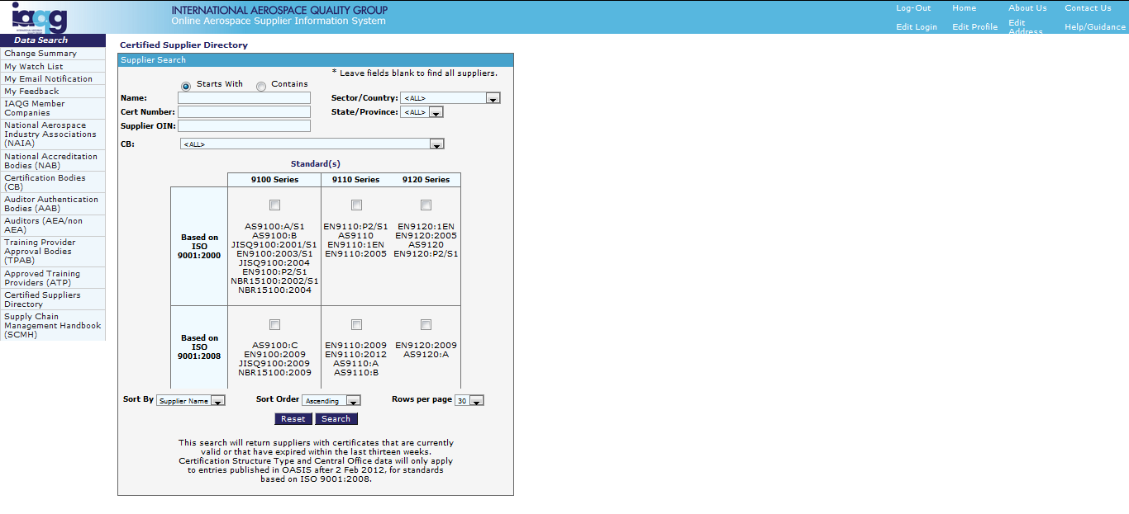
OASIS Public Section
Feedback – Path 2
Enter supplier
search
information
Click
to search

Slide 30
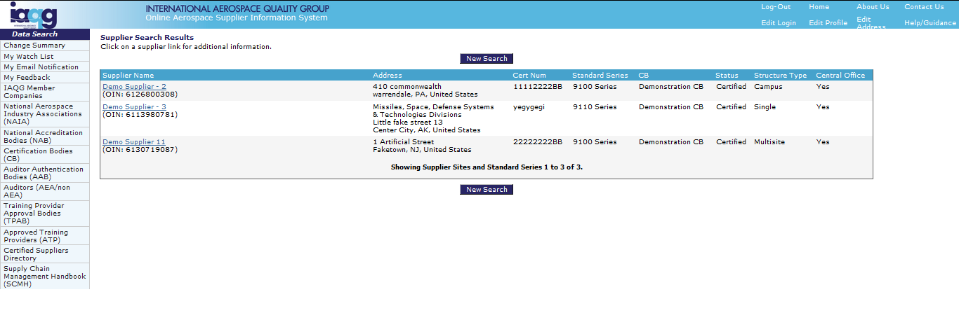
OASIS Public Section
Feedback – Path 2
Click to
select supplier

Slide 31
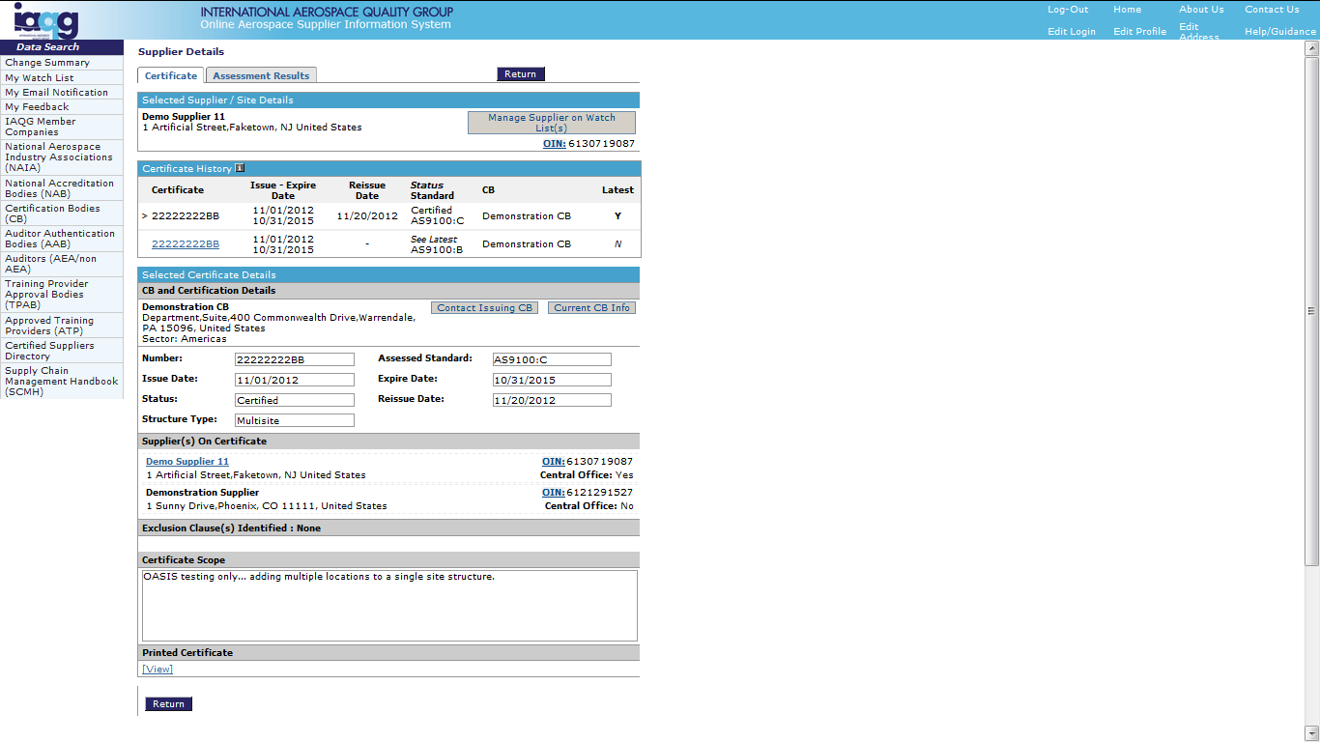
OASIS Public Section
Feedback – Path 2
Click to contact
issuing CB

Slide 32
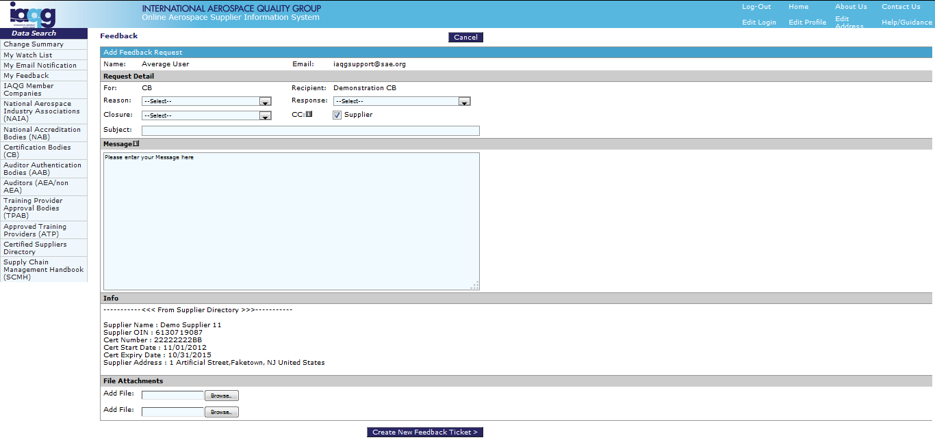
OASIS Public Section
Feedback – Path 2
CB is pre-selected
Carbon Copy (CC) to
supplier is pre-selected.
De-select if supplier
is not to be copied
on feedback
Enter details as with
Path 1
Click to send request
Feedback is received by CB/Supplier personnel with “Manage Feedback” privileges

Slide 33
OASIS User Training for Certification Bodies
Part 1 - Public Section
Training Content:
Overview✓
New Users✓
Login for Registered Users✓
The Main Screen✓
Change Summary✓
My Watch List✓
My Email Notification✓
Feedback – General✓
Feedback - Path 1
Feedback – Path 2
General Information Searches
IAQG Member Companies
National Aerospace Industry Associations
National Accreditation Bodies (NABs)
Certification Bodies (CBs)
Auditor Authentication Bodies (AABs)
Auditors (AEA/non-AEA)
Training Provider Approval Bodies (TPAB)
Approved Training Providers (ATP)
Certified Suppliers Directory
Help and Information

Slide 34
OASIS Public Section
General Information Searches
Click to
Access

Slide 35
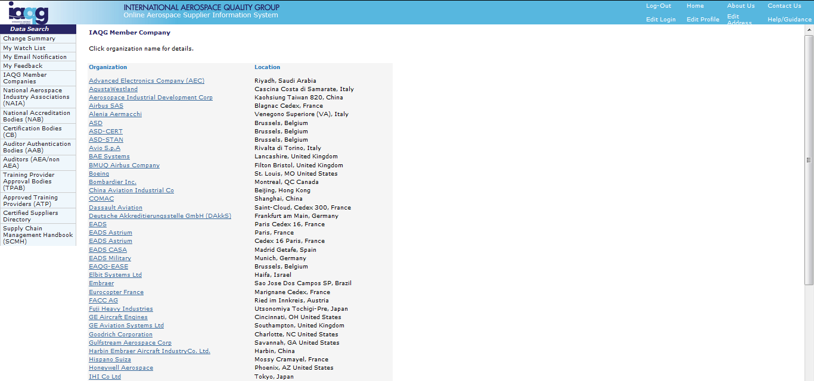
OASIS Public Section
IAQG Member Companies
Lists all organizations
that are considered
IAQG members for
OASIS-related purposes
Click to view
specific details

Slide 36
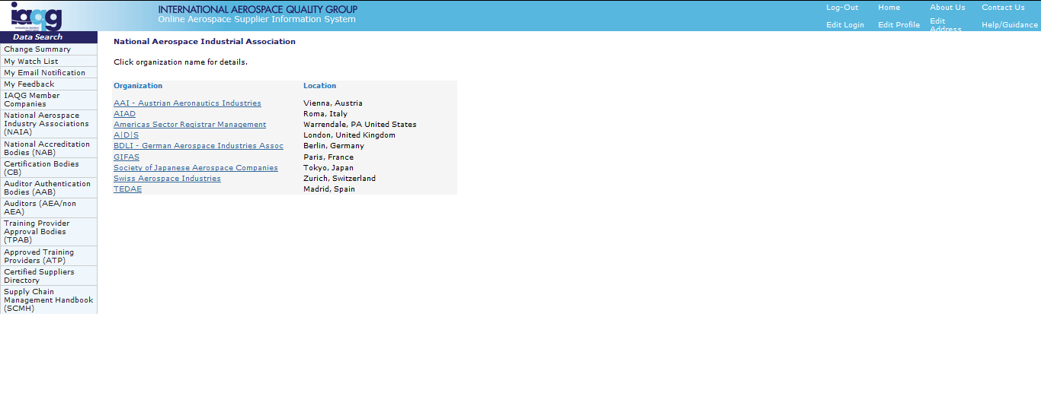
OASIS Public Section
National Aerospace Industry Associations
Lists all NAIA
OASIS participants
Click to view
specific details

Slide 37
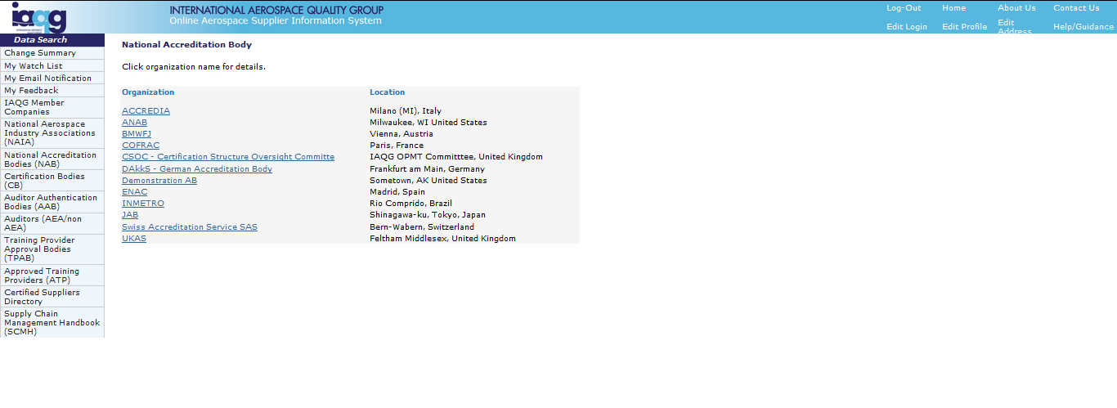
OASIS Public Section
National Accreditation Bodies (NABs)
Lists all NAB
OASIS participants
Click to view
specific details

Slide 38
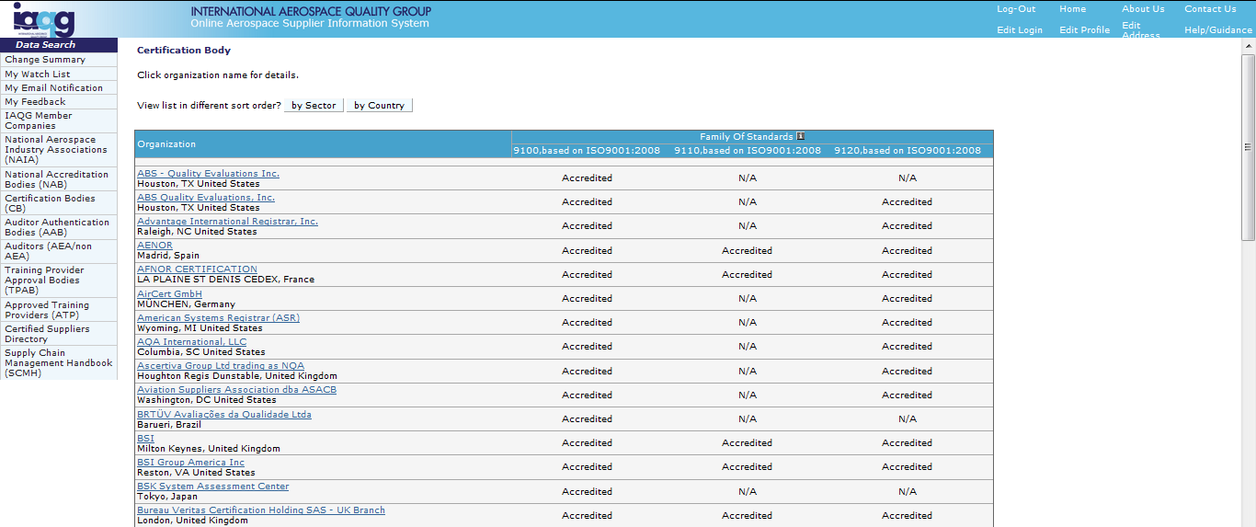
OASIS Public Section
Certification Bodies (CBs)
Shows Families of Standards
(FOS) accredited
Lists all National CB
OASIS participants
Click to organize by
Sector or Country
Shows status: Accredited,
Suspended or Withdrawn
Click to view
specific details

Slide 39
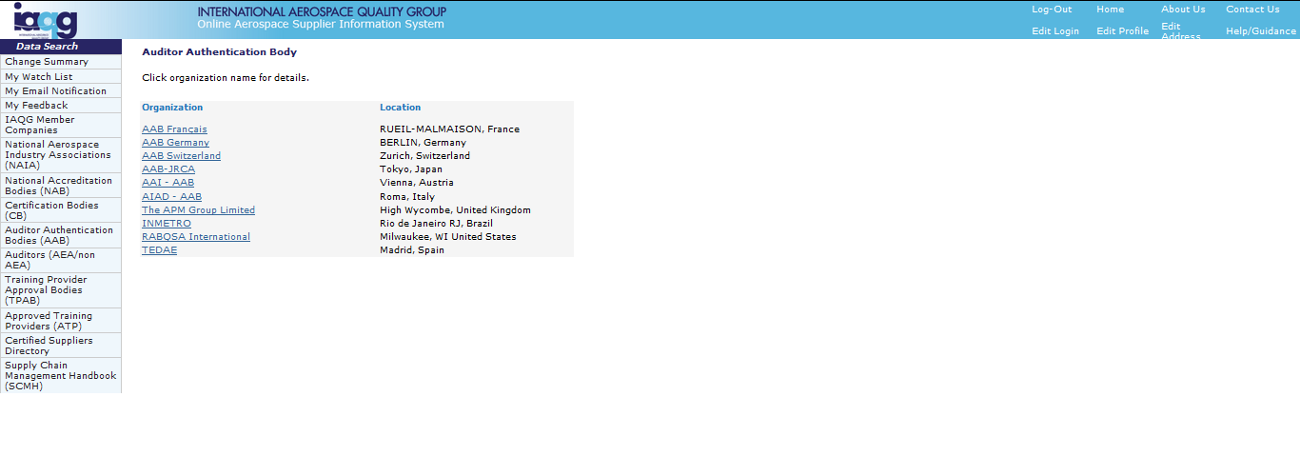
OASIS Public Section
Auditor Authentication Bodies (AABs)
Lists all AAB
OASIS participants
Click to view
specific details

Slide 40
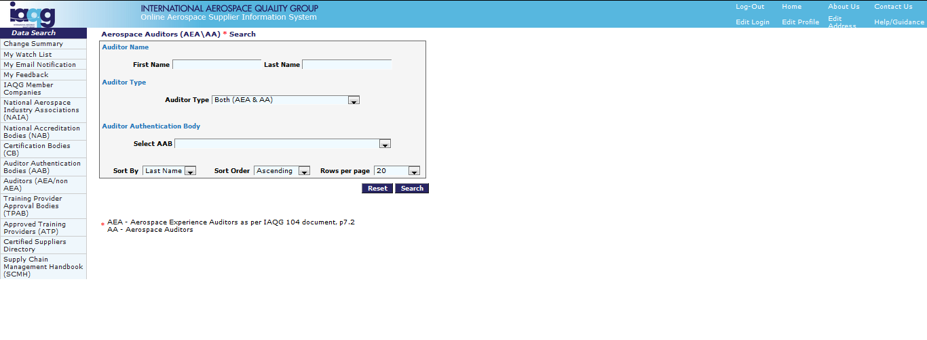
OASIS Public Section
Auditors (AEA or non AEA – i.e. AA)
Enter search parameters
or leave blank to see all
Click to view

Slide 41
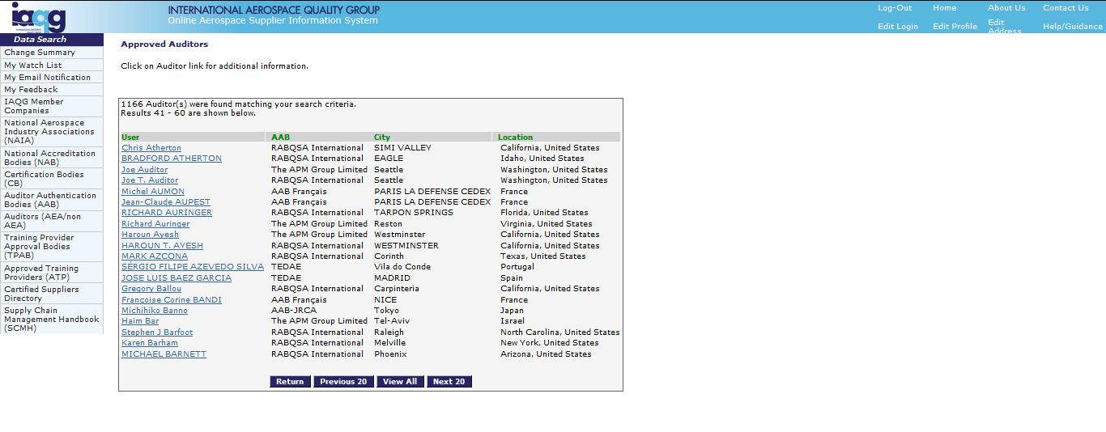
OASIS Public Section
Auditors (AEA or non AEA – i.e. AA)
Click to view
auditor status

Slide 42
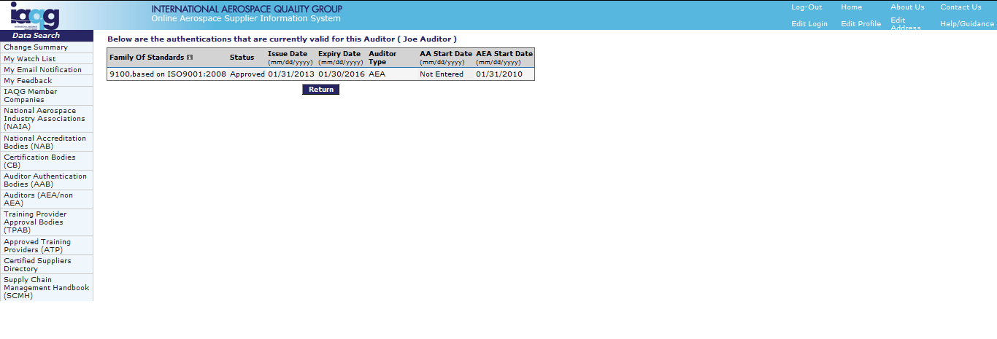
OASIS Public Section
Auditors (AEA or non AEA – i.e. AA)
View authentications
by FOS

Slide 43
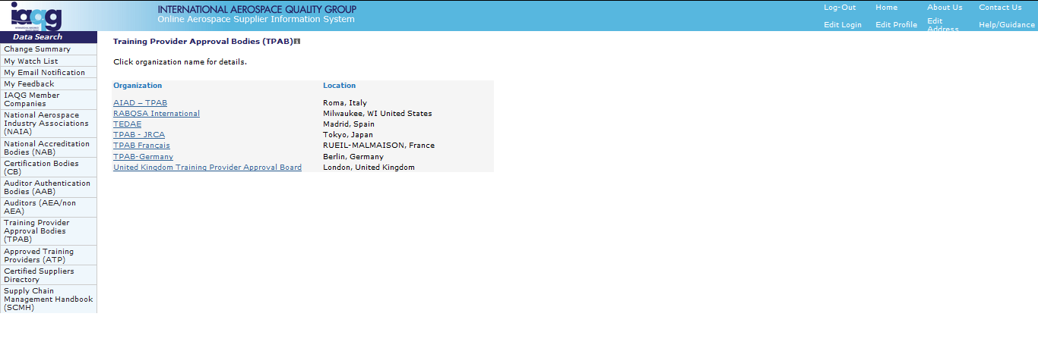
OASIS Public Section
Training Provider Approval Bodies (TPAB)
Click to view
specific details

Slide 44
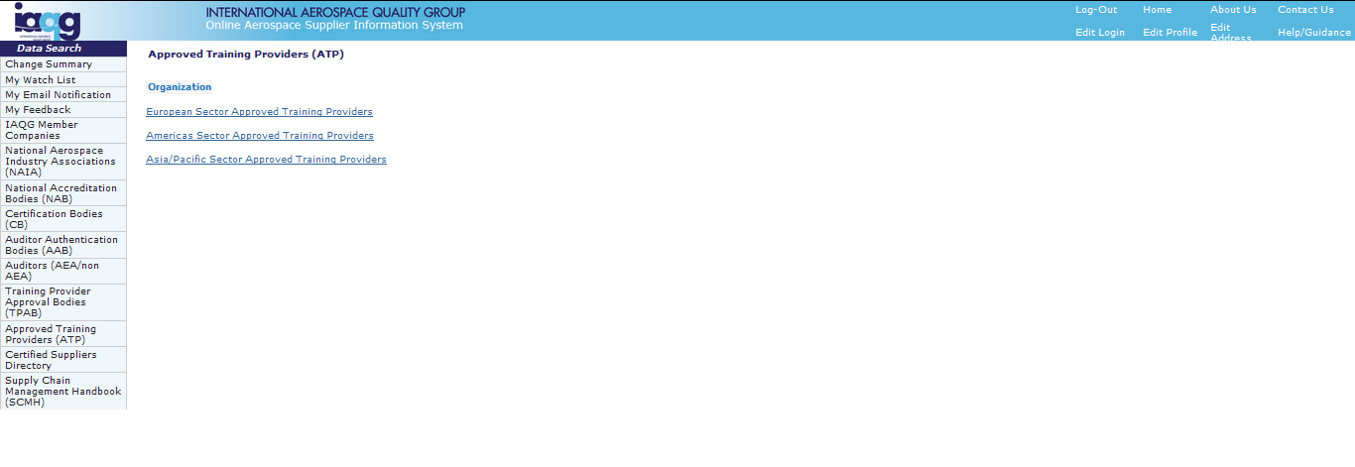
OASIS Public Section
Approved Training Providers (ATP)
Click to view list of
ATPs in each sector

Slide 45
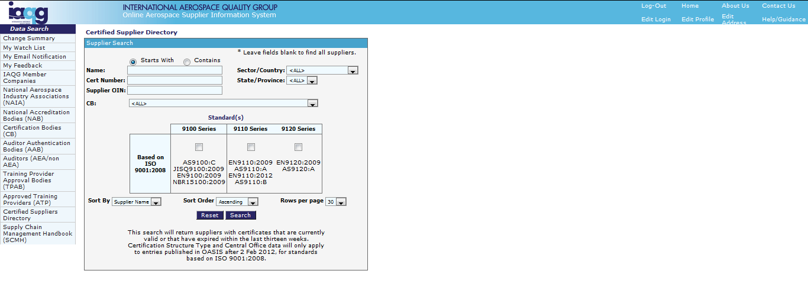
OASIS Public Section
Certified Suppliers Directory
Enter parameters
and click to search

Slide 46
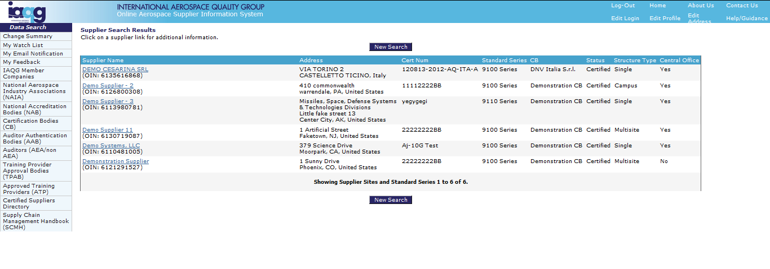
OASIS Public Section
Certified Suppliers Directory
Click for
additional detail

Slide 47
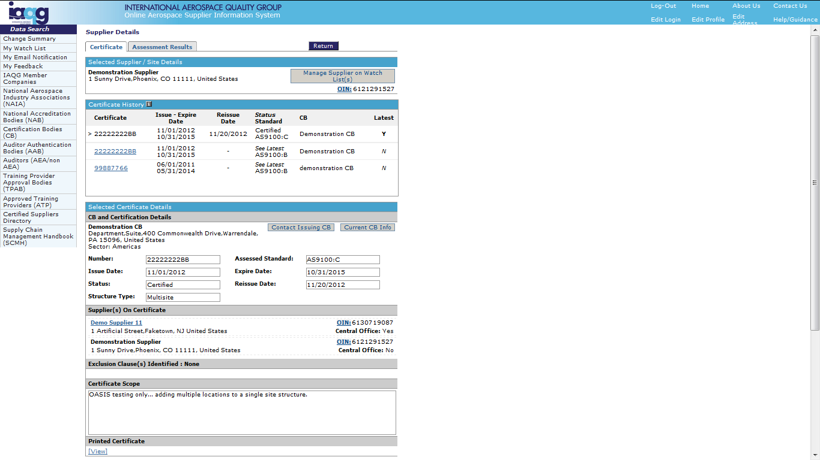
OASIS Public Section
Certified Suppliers Directory
Click to view
assessment results
Click to view
previously-issued
certificates
Click to view
the currently-issued
certificate

Slide 48
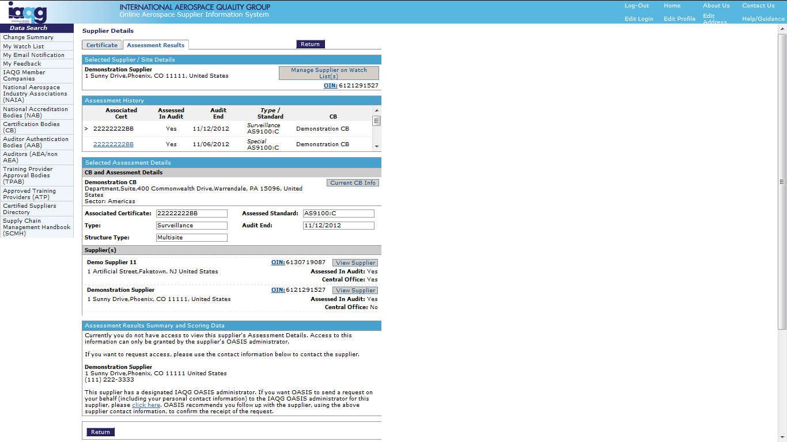
OASIS Public Section
Certified Suppliers Directory
Click to view
previous assessment
results
Assessment details only
visible if supplier has
granted data access

Slide 49
OASIS User Training for Certification Bodies
Part 1 - Public Section
Training Content:
Overview✓
New Users✓
Login for Registered Users✓
The Main Screen✓
Change Summary✓
My Watch List✓
My Email Notification✓
Feedback – General✓
Feedback - Path 1
Feedback – Path 2
General Information Searches✓
IAQG Member Companies
National Aerospace Industry Associations
National Accreditation Bodies (NABs)
Certification Bodies (CBs)
Auditor Authentication Bodies (AABs)
Auditors (AEA/non-AEA)
Training Provider Approval Bodies (TPAB)
Approved Training Providers (ATP)
Certified Suppliers Directory
Help and Information

Slide 50
OASIS Public Section
Help and Information
Click
“Help/Guidance”

Slide 51
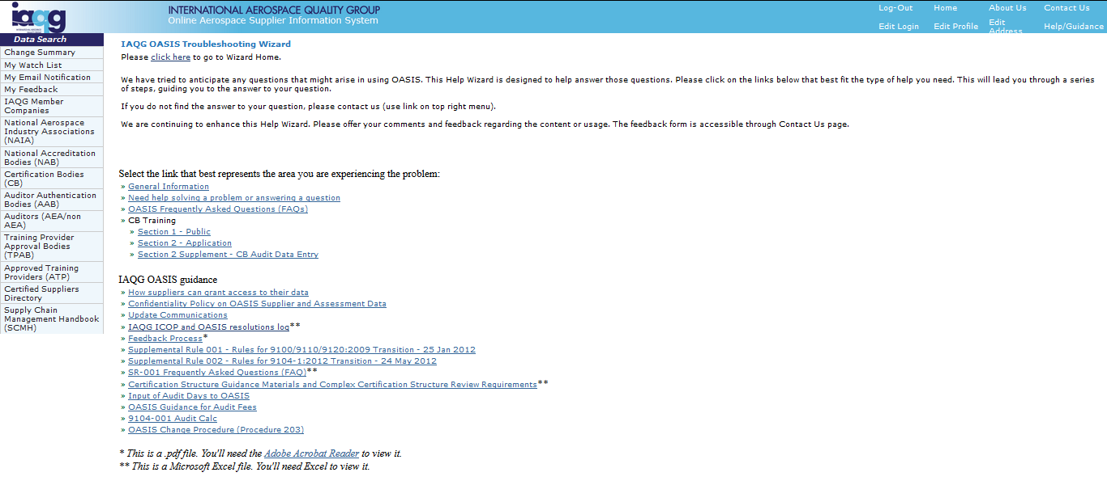
OASIS Public Section
Help and Information
Click
“Contact Us”
for technical
support
OASIS
Functionality
Help
IAQG/OASIS Guidance
Supplemental Rules
Resolution Log
Other Subjects

Slide 52
OASIS User Training for Certification Bodies
Part 1 - Public Section
Training Content:
Overview✓
New Users✓
Login for Registered Users✓
The Main Screen✓
Change Summary✓
My Watch List✓
My Email Notification✓
Feedback – General✓
Feedback - Path 1
Feedback – Path 2
General Information Searches✓
IAQG Member Companies
National Aerospace Industry Associations
National Accreditation Bodies (NABs)
Certification Bodies (CBs)
Auditor Authentication Bodies (AABs)
Auditors (AEA/non-AEA)
Training Provider Approval Bodies (TPAB)
Approved Training Providers (ATP)
Certified Suppliers Directory
Help and Information✓

Slide 53
OASIS Public Section

