Slide 1
OASIS User Training for Certification Bodies
Part 2 – Applications Section
July, 2013

Slide 2
OASIS User Training for Certification Bodies
Part 2 – Applications Section
Training Content:
  Overview
  The Main Screen
  Certificate / Assessment Add or Transfer
  Certificate / Assessment Modify
  Certificate / Assessment View Details
  Manage Feedback
  Reports
    Aggregate ARS
    Auditor Capacity
    Certificate Issue Dates
    Days to Upload
    Supplier Admins
  Supplier View
  Users – Manage
  Help - CB

Slide 3
OASIS User Training for Certification Bodies
Overview:
Background
  OASIS contains two primary sections
    Data Search (Public) Section
    Applications (User group-specific) Section
  OASIS uses English as its main language.
    Written skills associated with that language are essential.
Scope of Training
  This training is designed to provide detailed guidance for Certification
    Body (CB) personnel who will be entering data into OASIS
    Part 1 covers Public Section functions
    Part 2 covers Applications for the CB user group.

Slide 4
OASIS User Training for Certification Bodies
Part 2 – Applications Section
Training Content:
  Overview ✓
  The Main Screen
  Certificate / Assessment Add or Transfer
  Certificate / Assessment Modify
  Certificate / Assessment View Details
  Manage Feedback
  Reports
    Aggregate ARS
    Auditor Capacity
    Certificate Issue Dates
    Days to Upload
    Supplier Admins
  Supplier View
  Users – Manage
  Help - CB

Slide 5
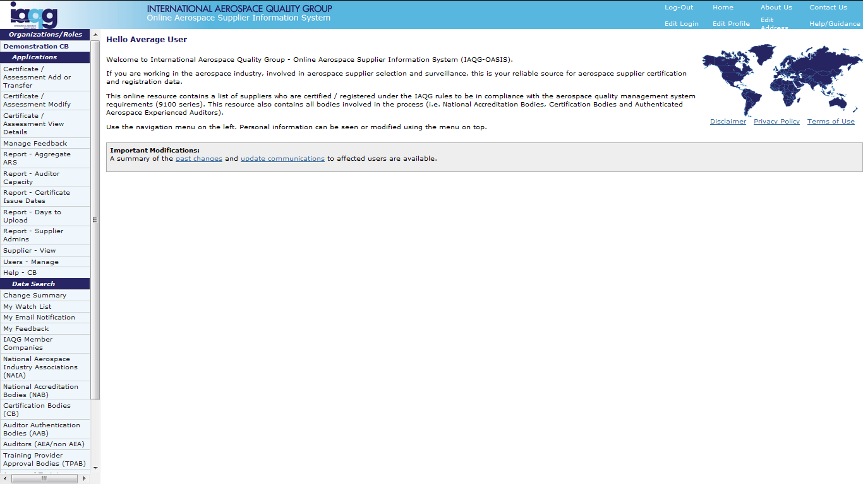
OASIS CB Applications Section
The Main Screen – CB Users
CB Applications
Section
Data Search
(Public) Section
Refer to OASIS User Training for Certification Bodies Part 1
for new user registration and general login instructions.

Slide 6
OASIS User Training for Certification Bodies
Part 2 – Applications Section
Training Content:
  Overview ✓
  The Main Screen ✓
  Certificate / Assessment Add or Transfer
  Certificate / Assessment Modify
  Certificate / Assessment View Details
  Manage Feedback
  Reports
    Aggregate ARS
    Auditor Capacity
    Certificate Issue Dates
    Days to Upload
    Supplier Admins
  Supplier View
  Users – Manage
  Help - CB

Slide 7
OASIS CB Applications Section
Certificate / Assessment Add: Initial Audit Data
Click to
access

Slide 8
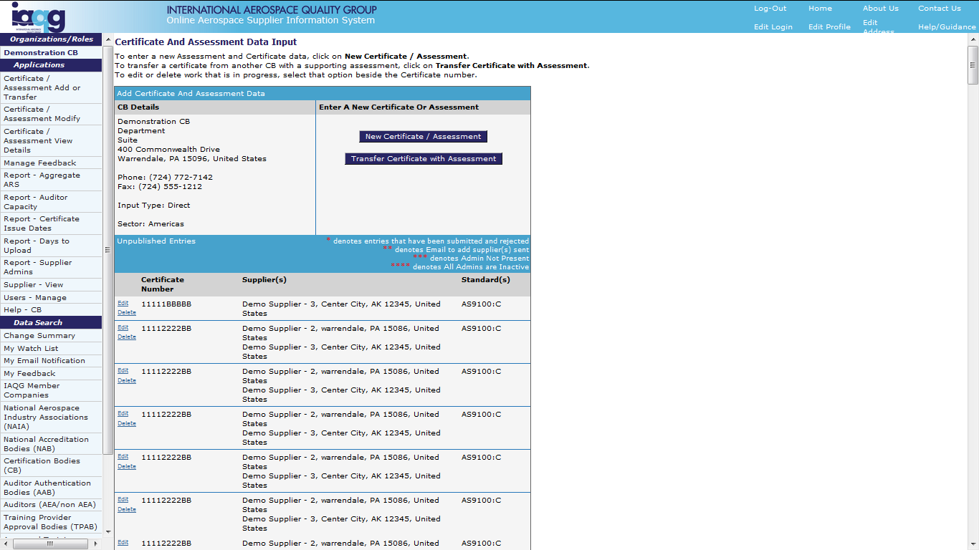
OASIS CB Applications Section
Certificate / Assessment Add: Initial Audit Data
Click to add
Note “ * ” and
meanings
Saved entries
not yet published

Slide 9
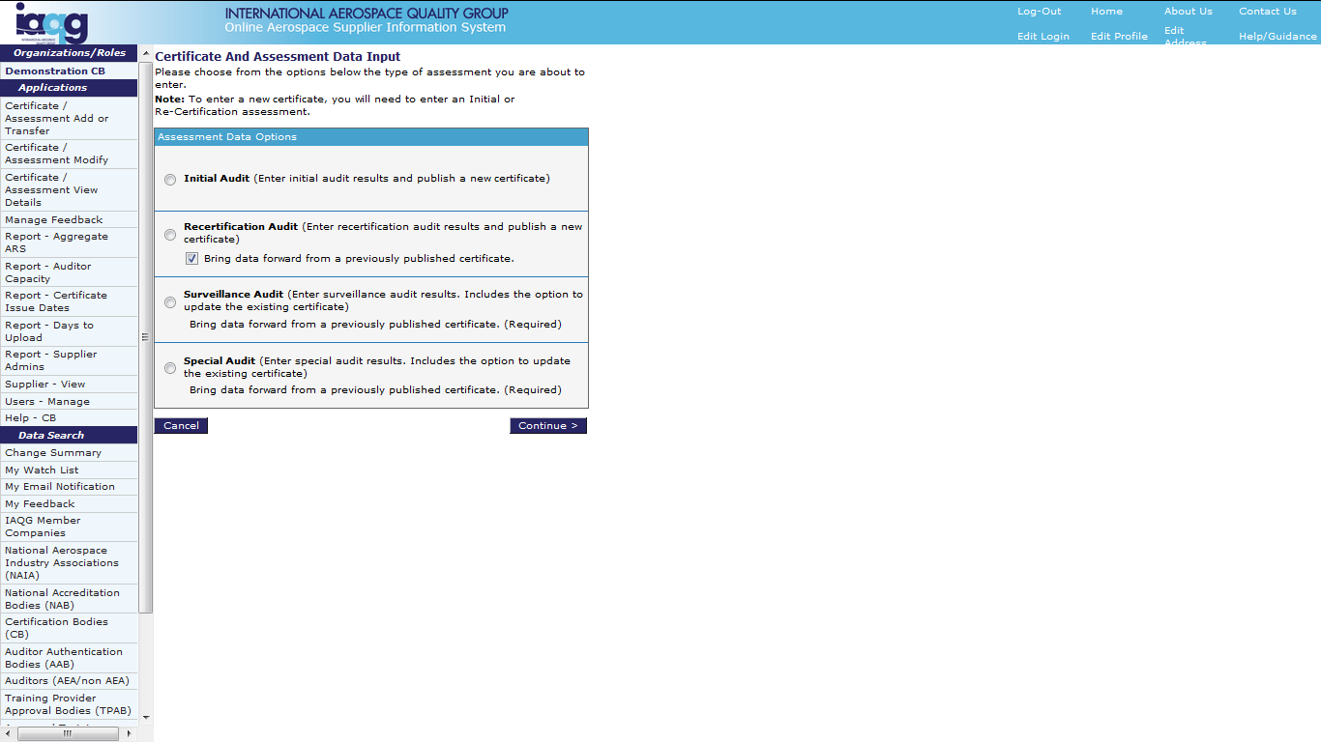
OASIS CB Applications Section
Certificate / Assessment Add: Initial Audit Data
  Four Options:
  Initial
  Recertification
  Surveillance
  Special
Select option and
click “Continue”

Slide 10
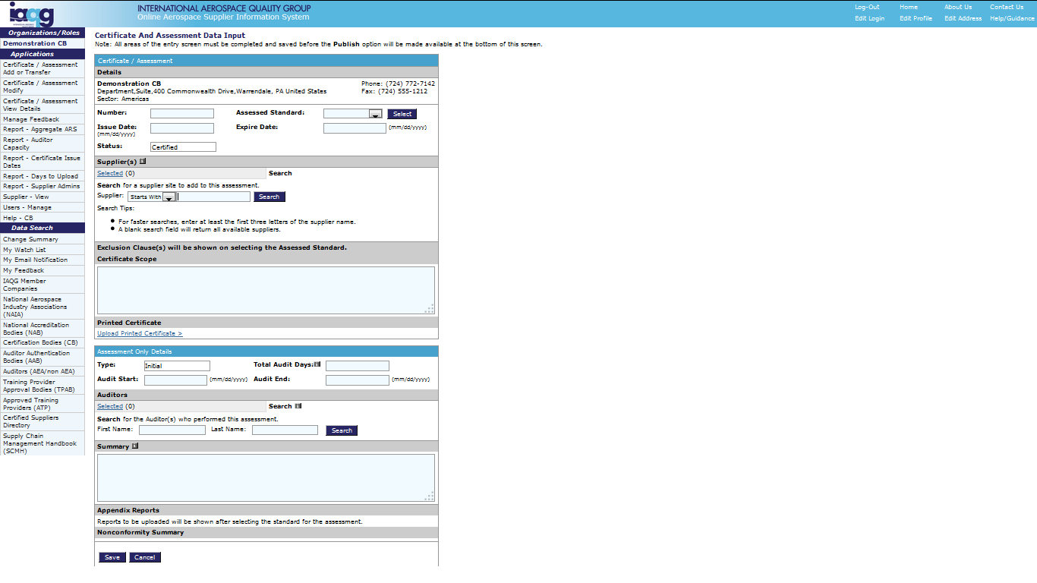
OASIS CB Applications Section
Certificate / Assessment Add: Initial Audit Data
Select certification standard
from drop-down list.
Then click “Select.”
Add additional certification
details to help locate
“saved” entries.
Enter at least part of the
supplier’s name, then
click “Search” to locate.

Slide 11
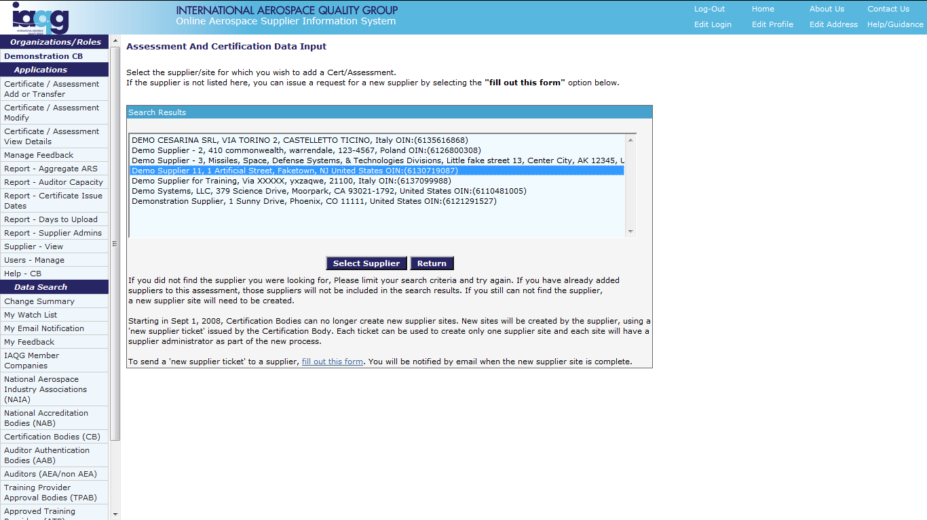
OASIS CB Applications Section
Certificate / Assessment Add: Initial Audit Data
Highlight
applicable
supplier
Then click
“Select Supplier”

Slide 12
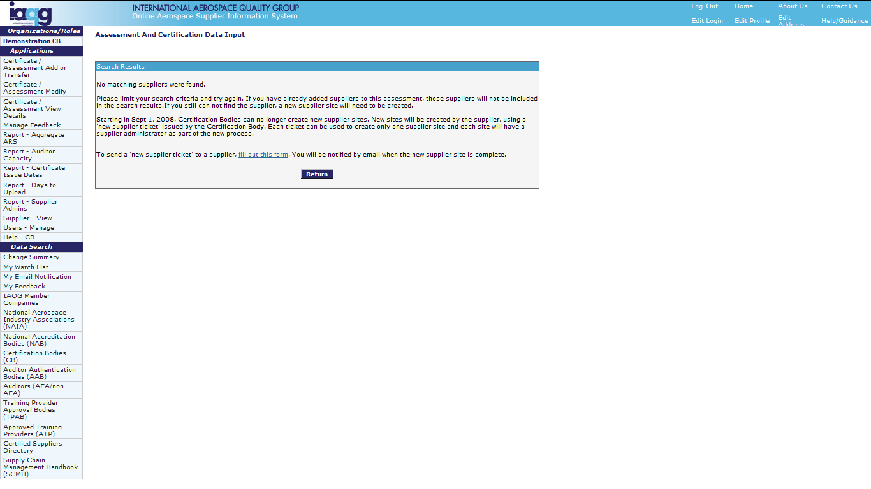
OASIS CB Applications Section
Certificate / Assessment Add: Initial Audit Data
If no matching supplier
is found, complete a
“New Supplier Ticket”
by clicking here.

Slide 13
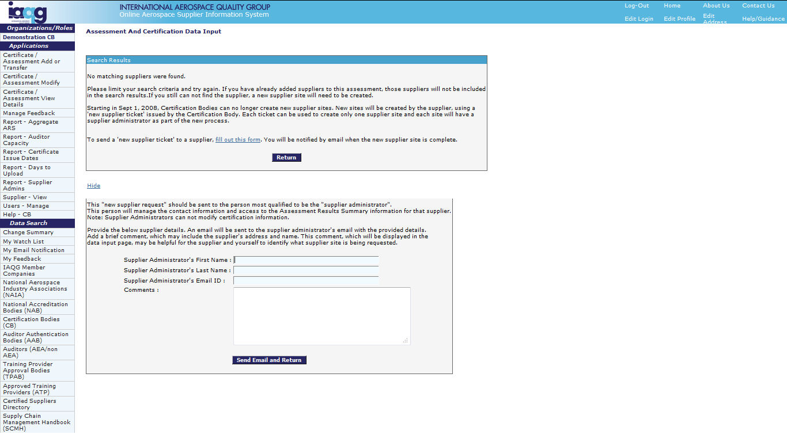
OASIS CB Applications Section
Certificate / Assessment Add: Initial Audit Data
Complete details:
Name
Email address
Comments
Then click “Send”

Slide 14
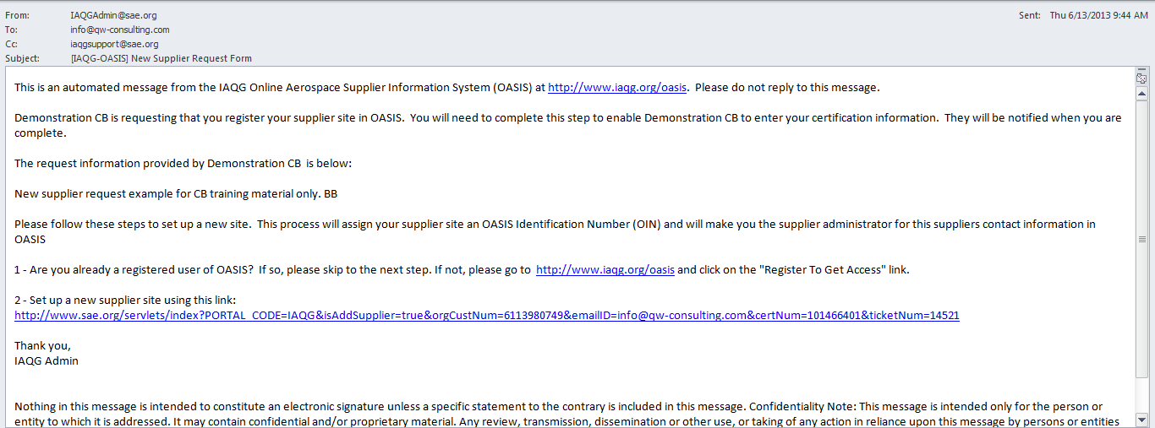
OASIS CB Applications Section
Certificate / Assessment Add: Initial Audit Data
Example email
request to supplier

Slide 15
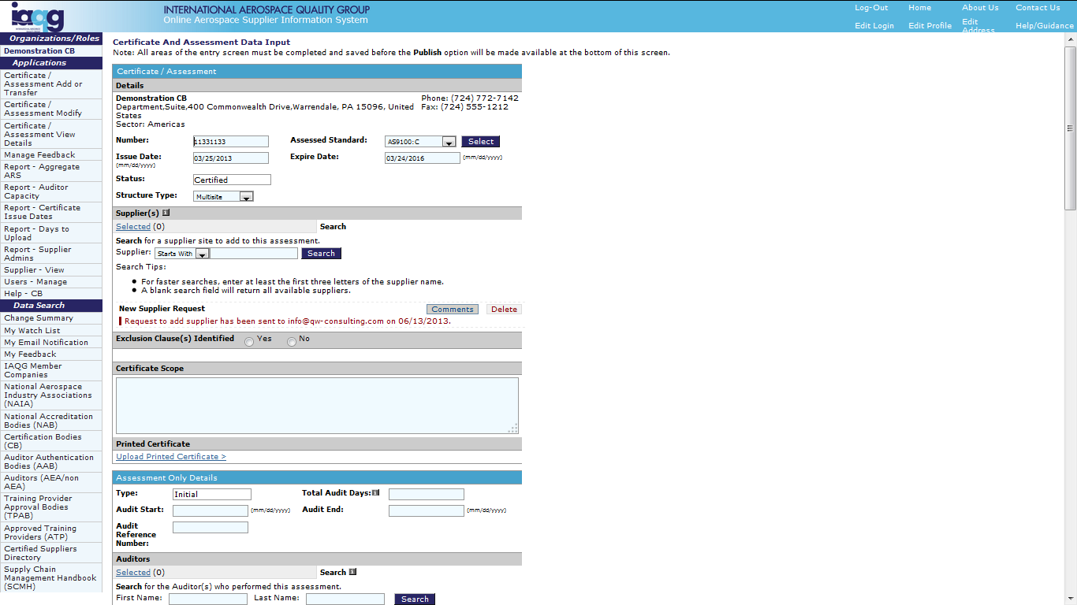
OASIS CB Applications Section
Certificate / Assessment Add: Initial Audit Data
Repeat search
for additional sites
Confirmation that
request has been
sent to the supplier

Slide 16
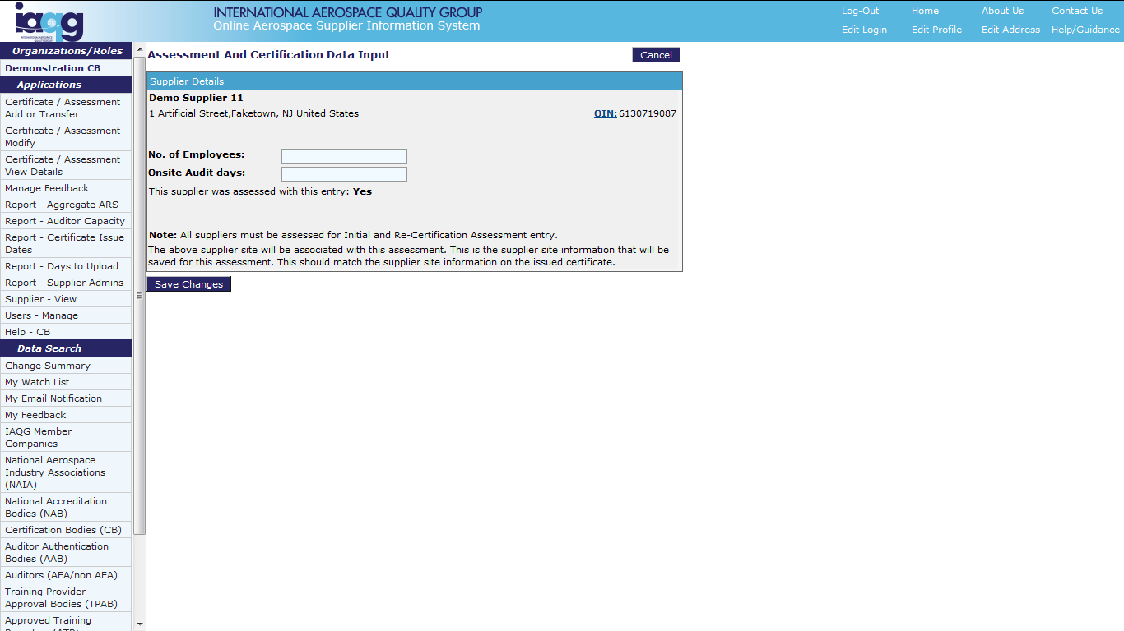
OASIS CB Applications Section
Certificate / Assessment Add: Initial Audit Data
Enter number of
supplier employees
and onsite audit days
Click to Save Changes

Slide 17
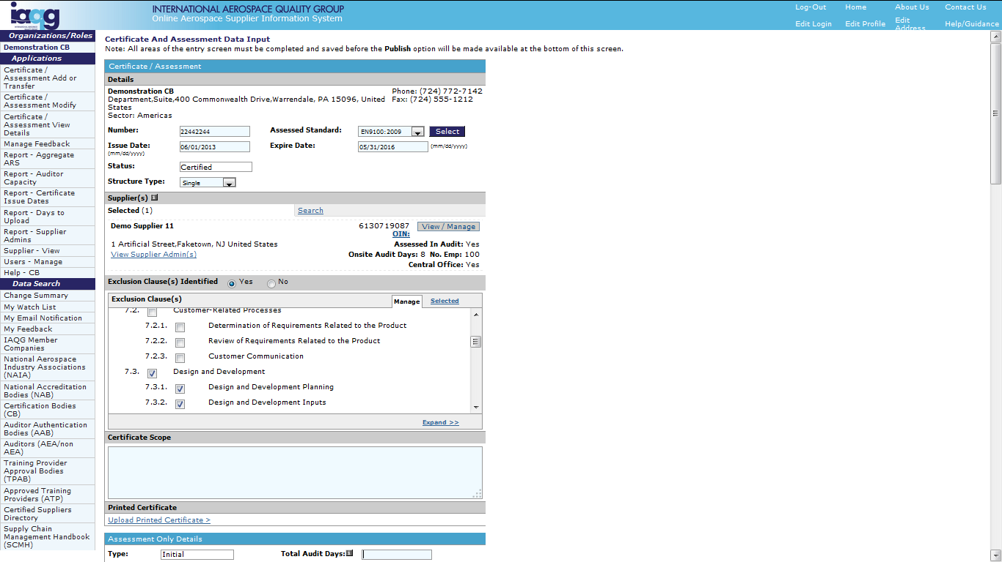
OASIS CB Applications Section
Certificate / Assessment Add: Initial Audit Data
Enter certificate
structure type from
drop-down selection
View supplier OASIS
Administrator contact
information
Select whether
exclusion clauses
were identified
Identify exclusions
as applicable

Slide 18
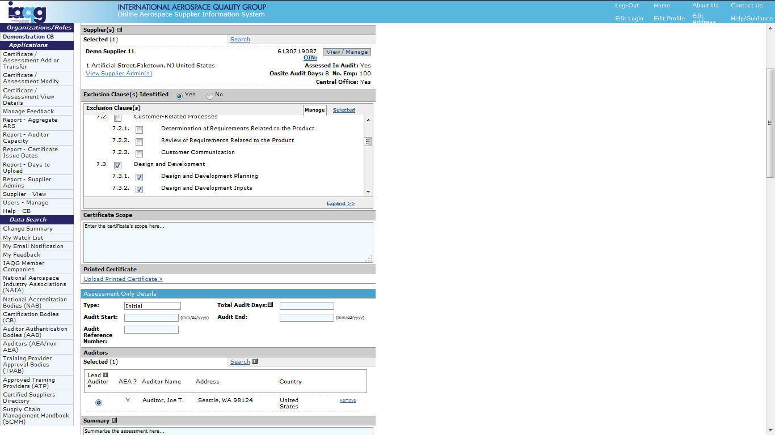
OASIS CB Applications Section
Certificate / Assessment Add: Initial Audit Data
Enter certificate scope
using same wording as
on certificate. Use English
And Local language.
Upload .pdf copy
of certificate
Enter assessment details.
Note: Total Audit Days =
Total On-site Days

Slide 19
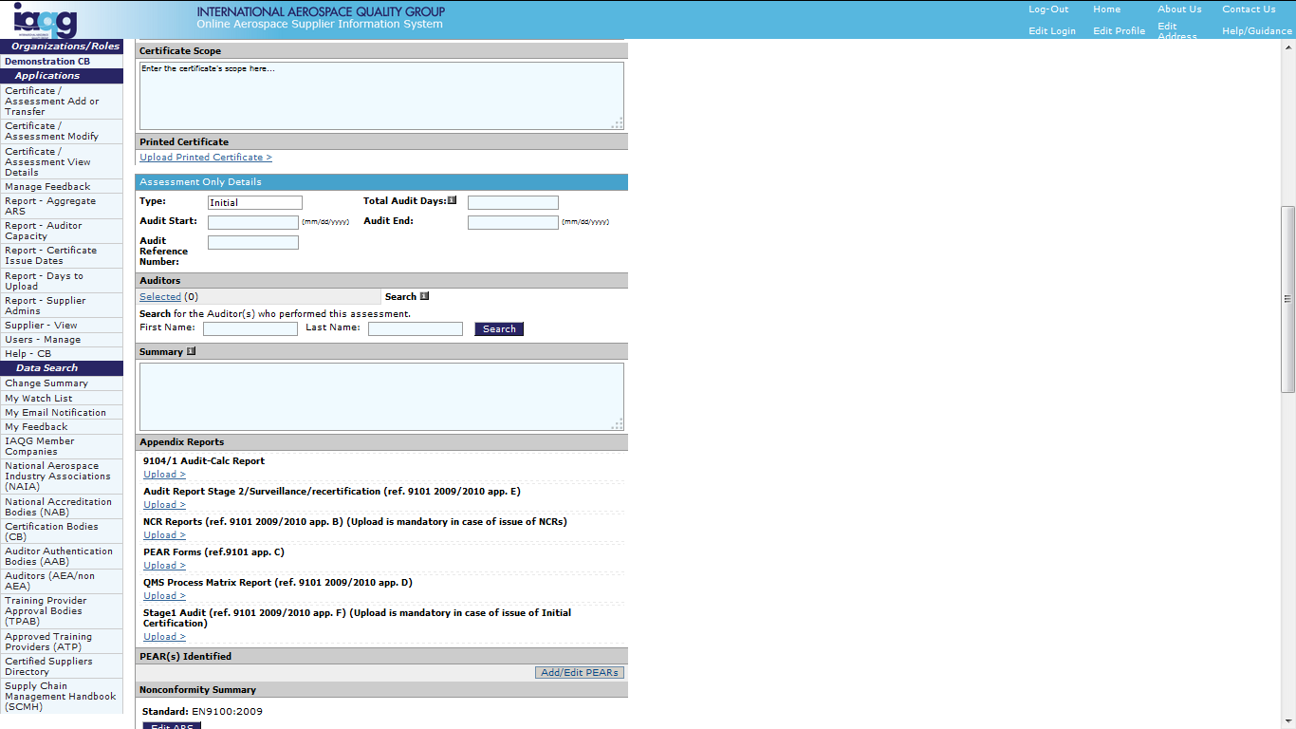
OASIS CB Applications Section
Certificate / Assessment Add: Initial Audit Data
Enter at least part of the
auditor’s name, then
click “Search” to locate.
Repeat for all audit
team members.

Slide 20
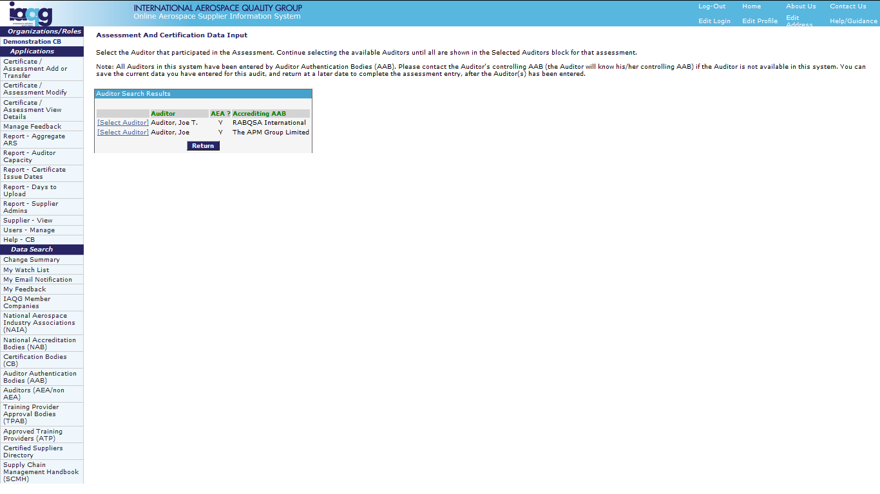
OASIS CB Applications Section
Certificate / Assessment Add: Initial Audit Data
Locate auditor,
then click
“Select Auditor”
Click “Return” if
search did not
find auditor

Slide 21
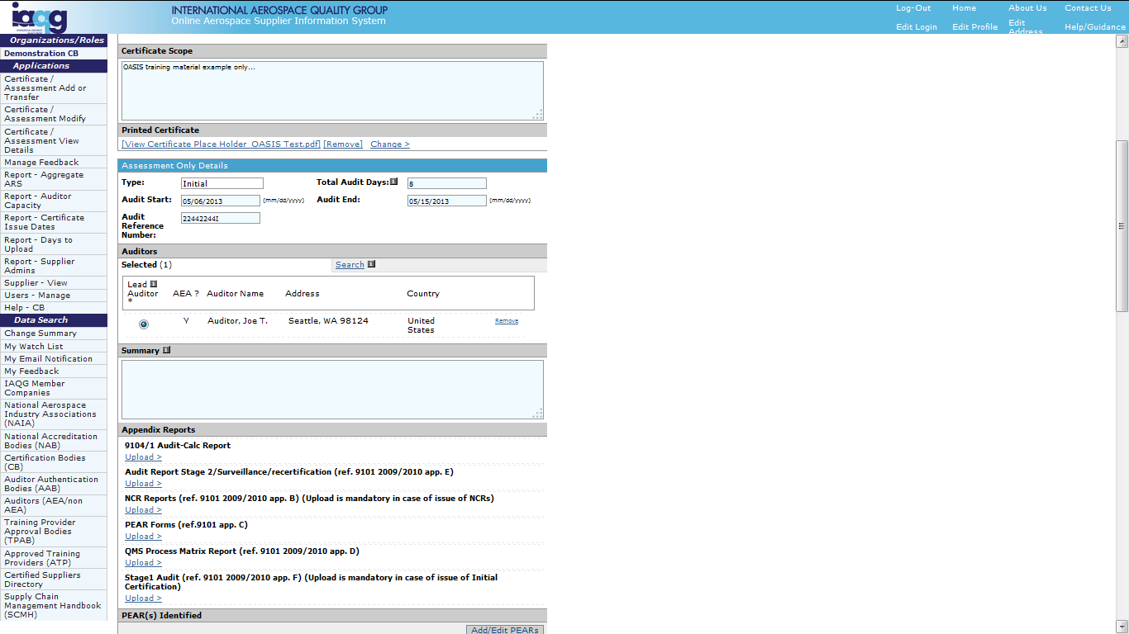
OASIS CB Applications Section
Certificate / Assessment Add: Initial Audit Data
Enter all audit team
members. Then click to
identify the “Lead Auditor”
Copy/paste the
audit report
summary

Slide 22
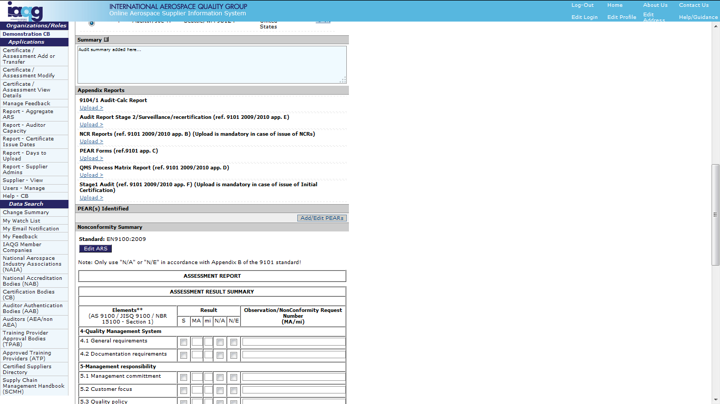
OASIS CB Applications Section
Certificate / Assessment Add: Initial Audit Data
Upload required documents.
Note: Uploads must
be in .pdf format
Click to enter PEARs

Slide 23
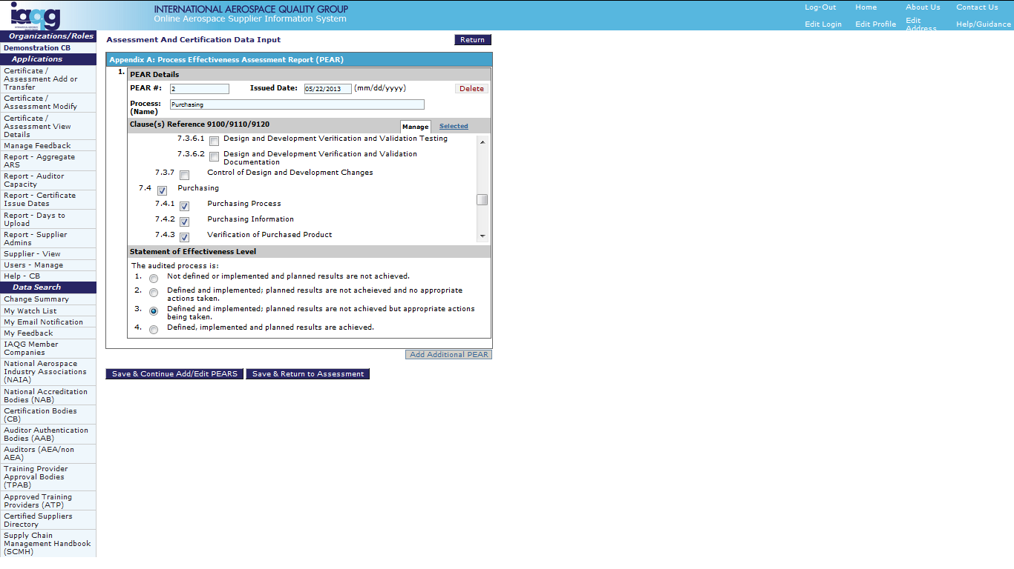
OASIS CB Applications Section
Certificate / Assessment Add: Initial Audit Data
Enter PEAR details,
clauses referenced and
level of effectiveness
Click to add
additional PEARs
Click to save
as indicated

Slide 24
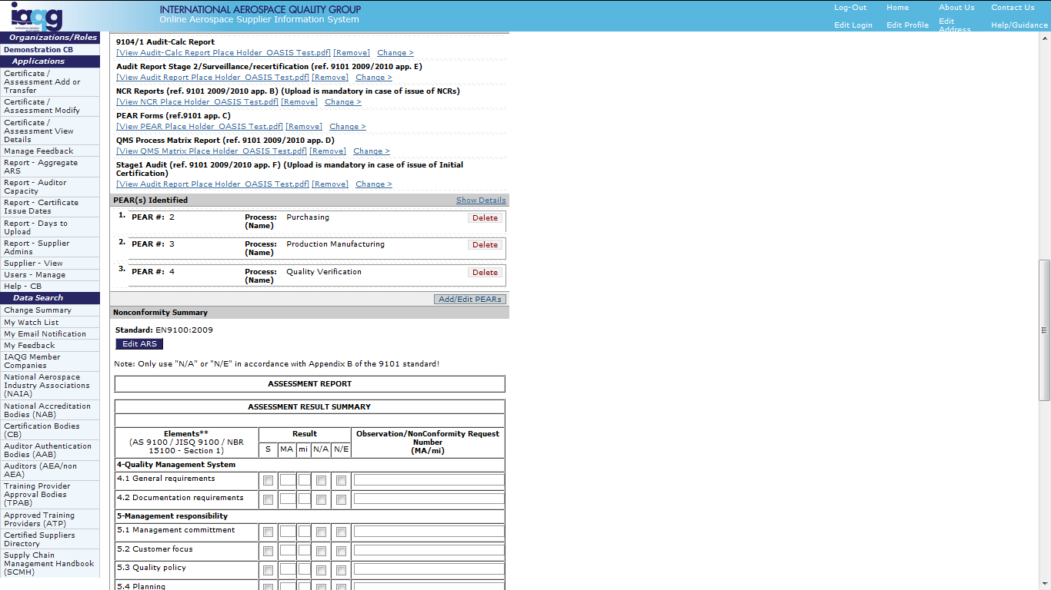
OASIS CB Applications Section
Certificate / Assessment Add: Initial Audit Data
Click to enter
Assessment Result
Summary

Slide 25
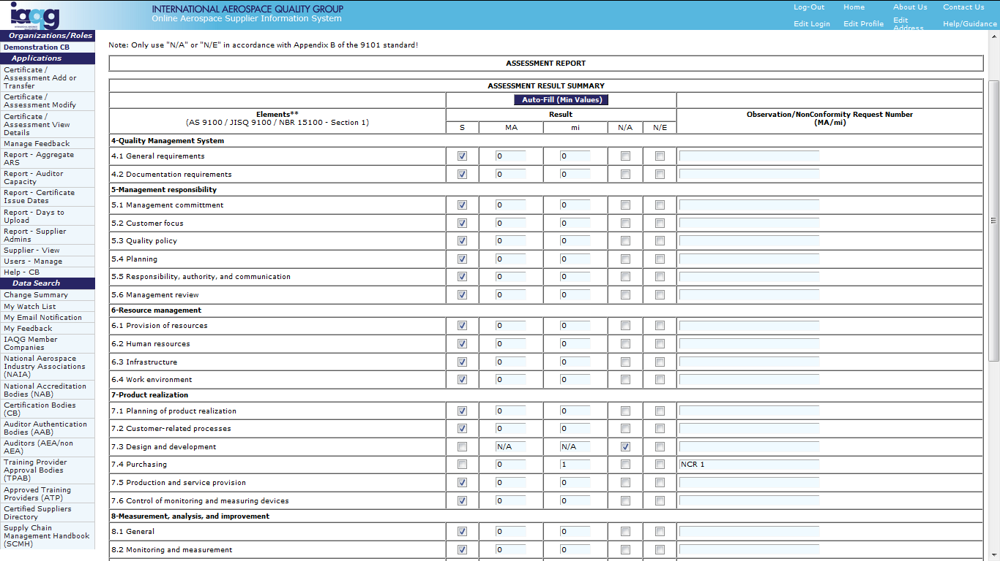
OASIS CB Applications Section
Certificate / Assessment Add: Initial Audit Data
Click N/A for permissible
exclusions (Clause 7 only).
N/E not allowed for
initial and recertification
audit reports.
Minimum values may
be auto-filled, then
individually “un-checked”
for exclusions or
nonconformities

Slide 26
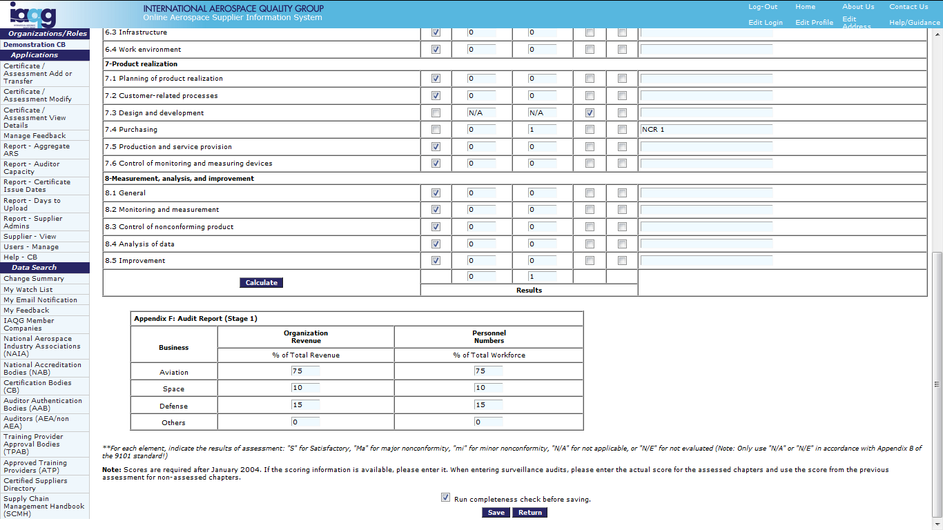
OASIS CB Applications Section
Certificate / Assessment Add: Initial Audit Data
Click to show
total number of
nonconformities
Enter estimated
business percentages
“Run completeness check”
and Save upon completion.

Slide 27
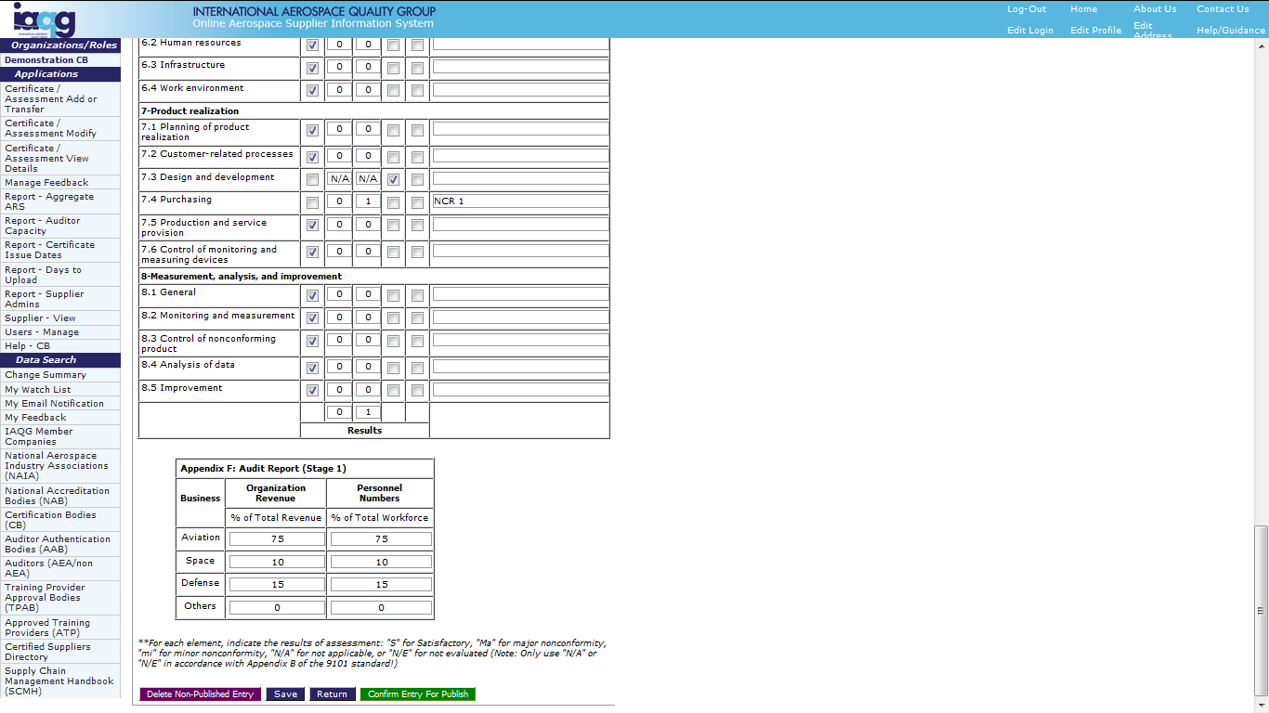
OASIS CB Applications Section
Certificate / Assessment Add: Initial Audit Data
Only use to fully
delete entry before
publication.
Always click “Save.”
When fully complete,
click the Green button
to publish the entry.

Slide 28
OASIS CB Applications Section
Certificate / Assessment Add: Initial Audit Data
Note: In some countries (e.g. Italy),
clicking the Green confirmation button
forwards the entry for approval. That
approval applies to all new assessment
entries: Initial, Surveillance, Recertification
and Special. The entry will only become
publicly visible when approved.

Slide 29
OASIS CB Applications Section
Certificate / Assessment Add: Re-certification Audit Data
Click to
access

Slide 30
OASIS CB Applications Section
Certificate / Assessment Add: Re-certification Audit Data
Click to add
Note “ * ” and
meanings
Saved entries
not yet published

Slide 31

OASIS CB Applications Section
Certificate / Assessment Add: Re-certification Audit Data
Re-certification entry includes
an option to bring forward data
from an existing certification.
WARNING
DO NOT use “Modify” to
add a NEW re-certification
or surveillance audit

Slide 32
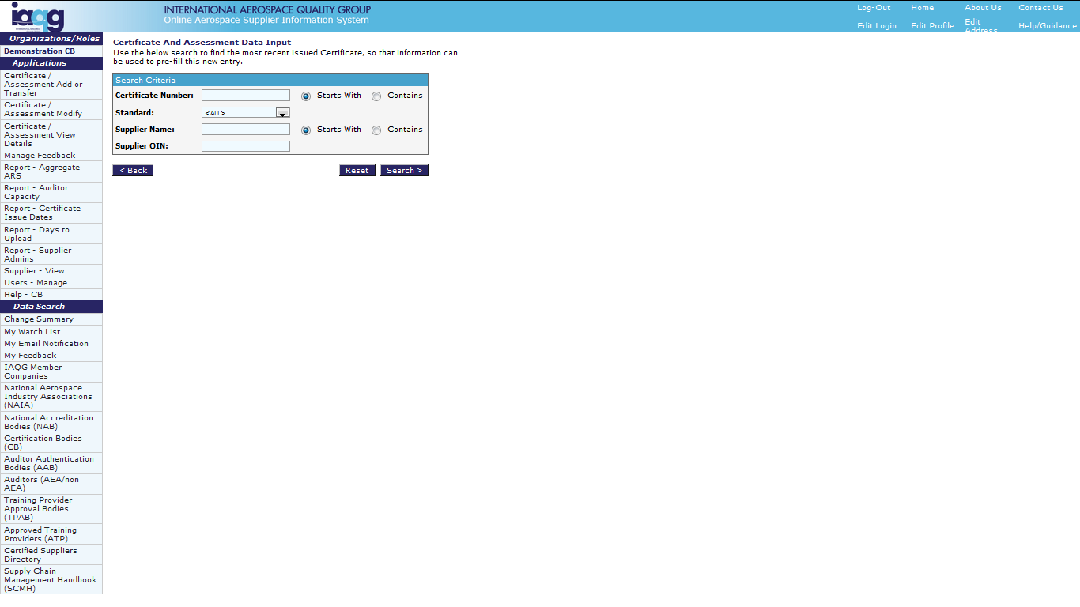
OASIS CB Applications Section
Certificate / Assessment Add: Re-certification Audit Data
Enter parameters,
then click “Search”
Search auto-filters to only list
certificates that are issued
by your CB organization

Slide 33
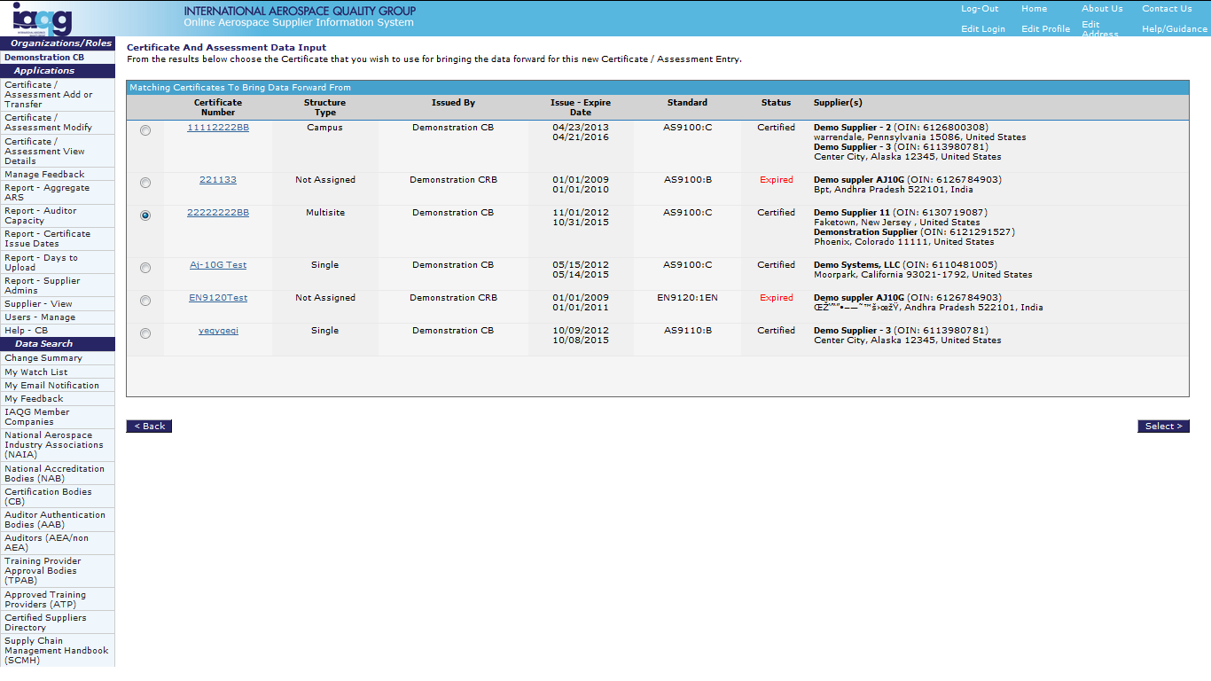
OASIS CB Applications Section
Certificate / Assessment Add: Re-certification Audit Data
Select correct
certification
Then click
“Select”

Slide 34
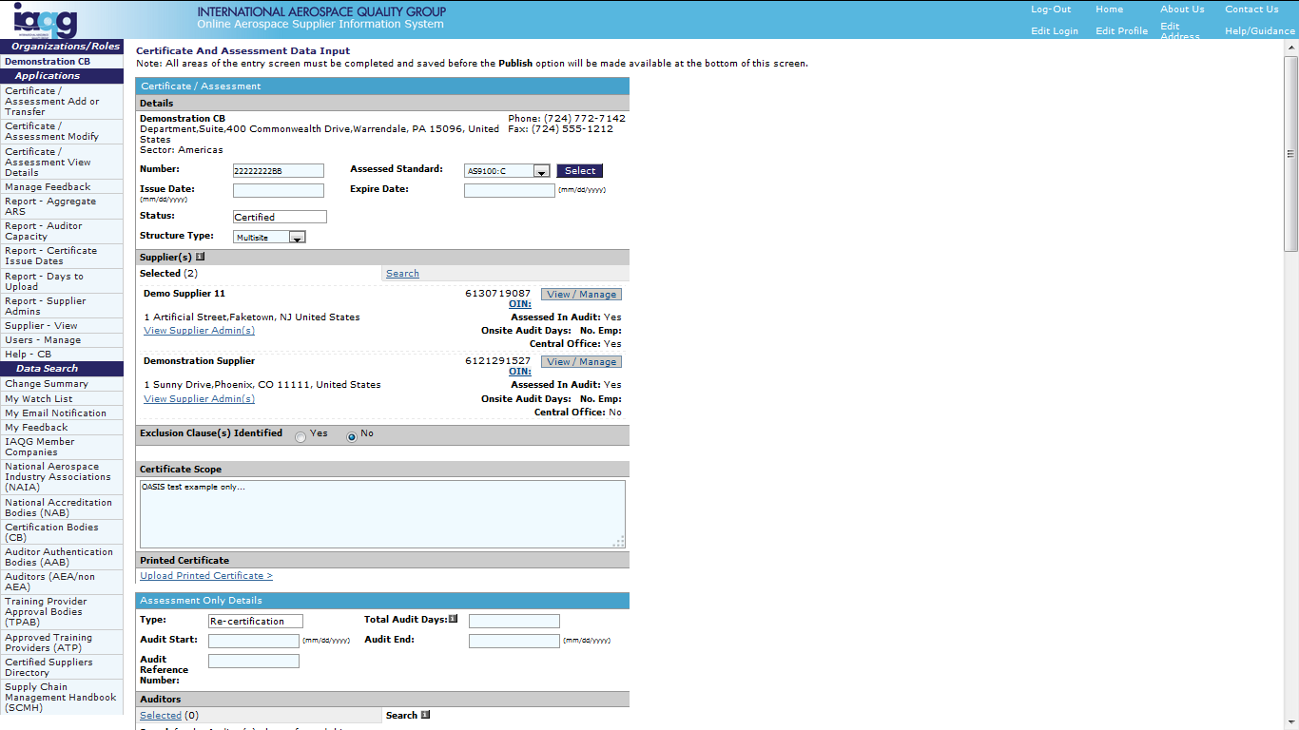
OASIS CB Applications Section
Certificate / Assessment Add: Re-certification Audit Data
Always select “View/Manage”
to update supplier information
Verify supplier
administrator

Slide 35
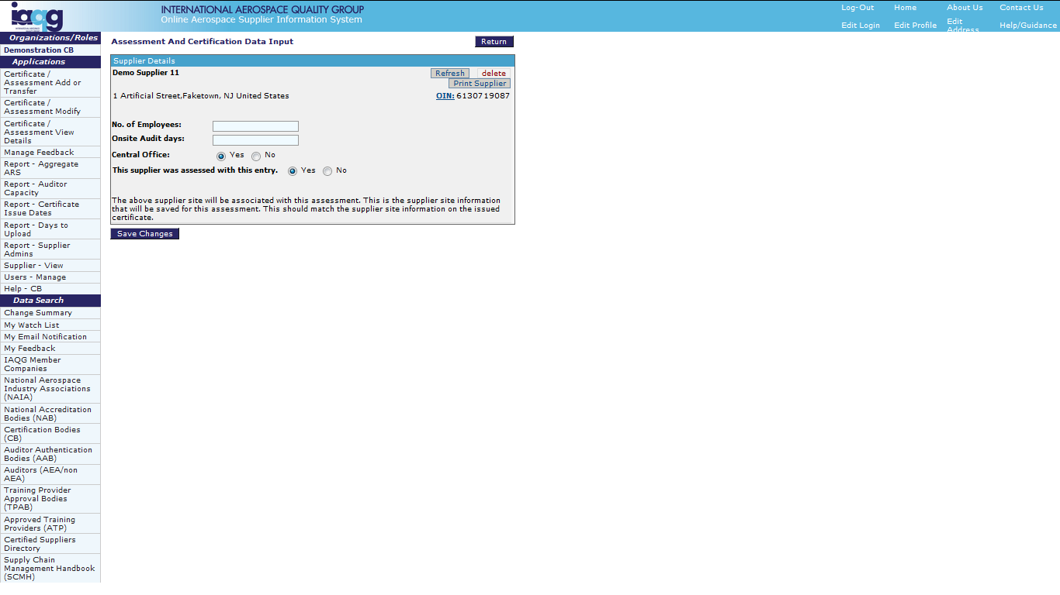
OASIS CB Applications Section
Certificate / Assessment Add: Re-certification Audit Data
Click “Refresh” to update
data maintained by the
Supplier Administrator
Ensure all information
is correct and up to date.
Click to save
any changes

Slide 36
OASIS CB Applications Section
Certificate / Assessment Add: Re-certification Audit Data
All other data entry
is the same as for
“Initial Audit Data”

Slide 37
OASIS CB Applications Section
Certificate / Assessment Add: Surveillance Audit Data
Click to
access

Slide 38
OASIS CB Applications Section
Certificate / Assessment Add: Surveillance Audit Data
Click to add
Note “ * ” and
meanings
Saved entries
not yet published

Slide 39
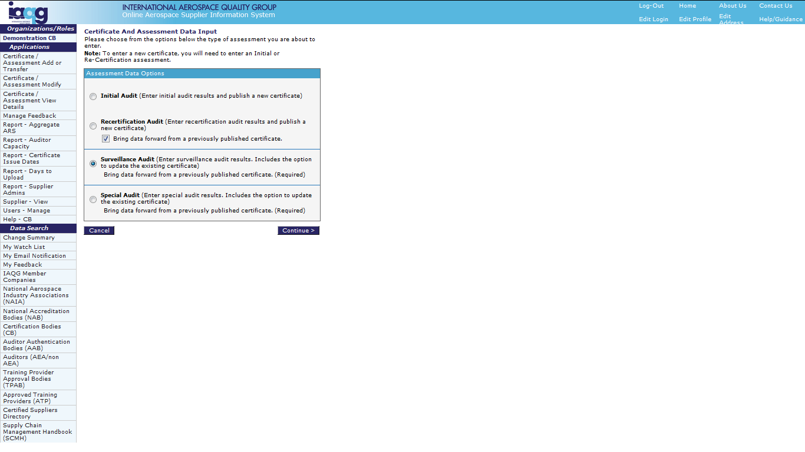
OASIS CB Applications Section
Certificate / Assessment Add: Surveillance Audit Data
Surveillance entry requires that
data is brought forward from
an existing certification
WARNING
DO NOT use “Modify” to
add a NEW re-certification
or surveillance audit

Slide 40
OASIS CB Applications Section
Certificate / Assessment Add: Surveillance Audit Data
Enter parameters,
then click “Search”
Search auto-filters to only list
certificates that are issued
by your CB organization

Slide 41
OASIS CB Applications Section
Certificate / Assessment Add: Surveillance Audit Data
Select correct
certification
Then click
“Select”

Slide 42
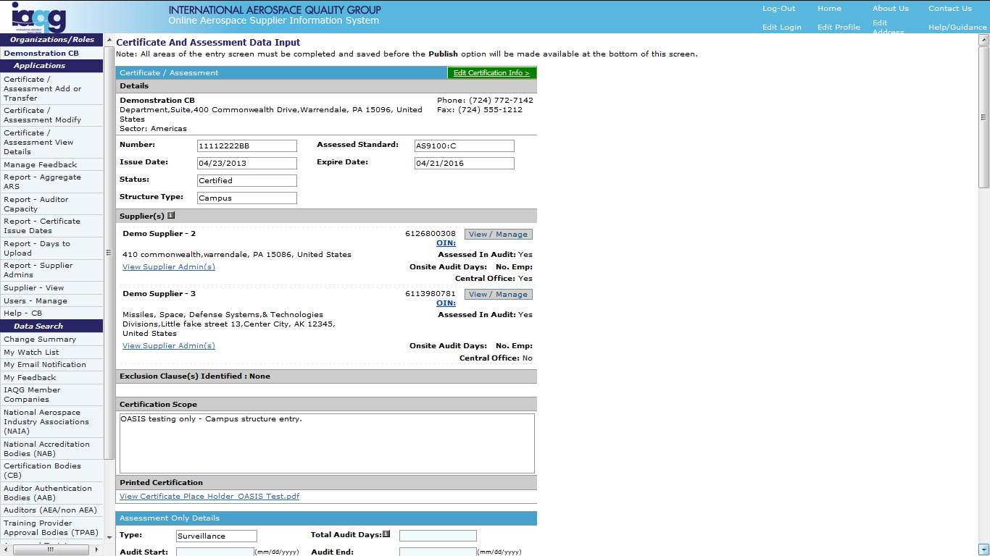
OASIS CB Applications Section
Certificate / Assessment Add: Surveillance Audit Data
Certification data may be edited
by clicking this Green button.
Note: Editing the certification
data requires re-issuance
of the certificate.

Slide 43
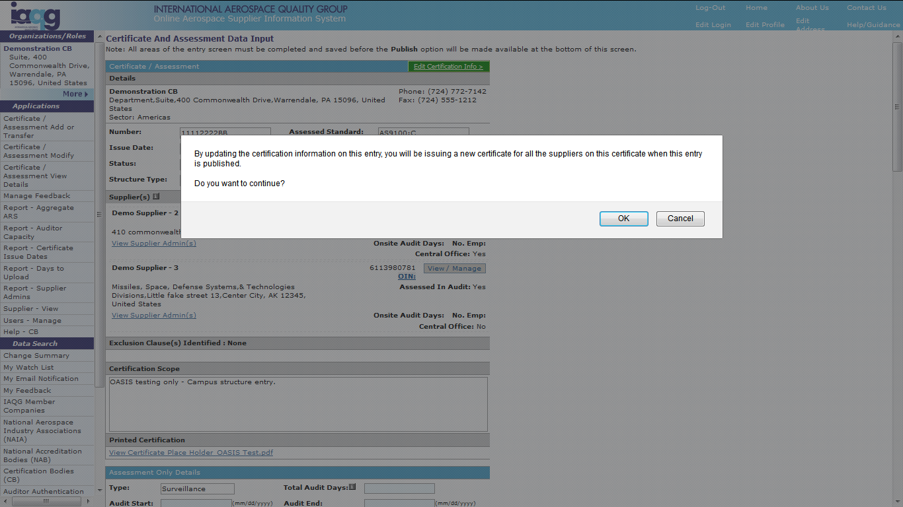
OASIS CB Applications Section
Certificate / Assessment Add: Surveillance Audit Data
Warning when changing
certification data. Click
“OK” to proceed.

Slide 44
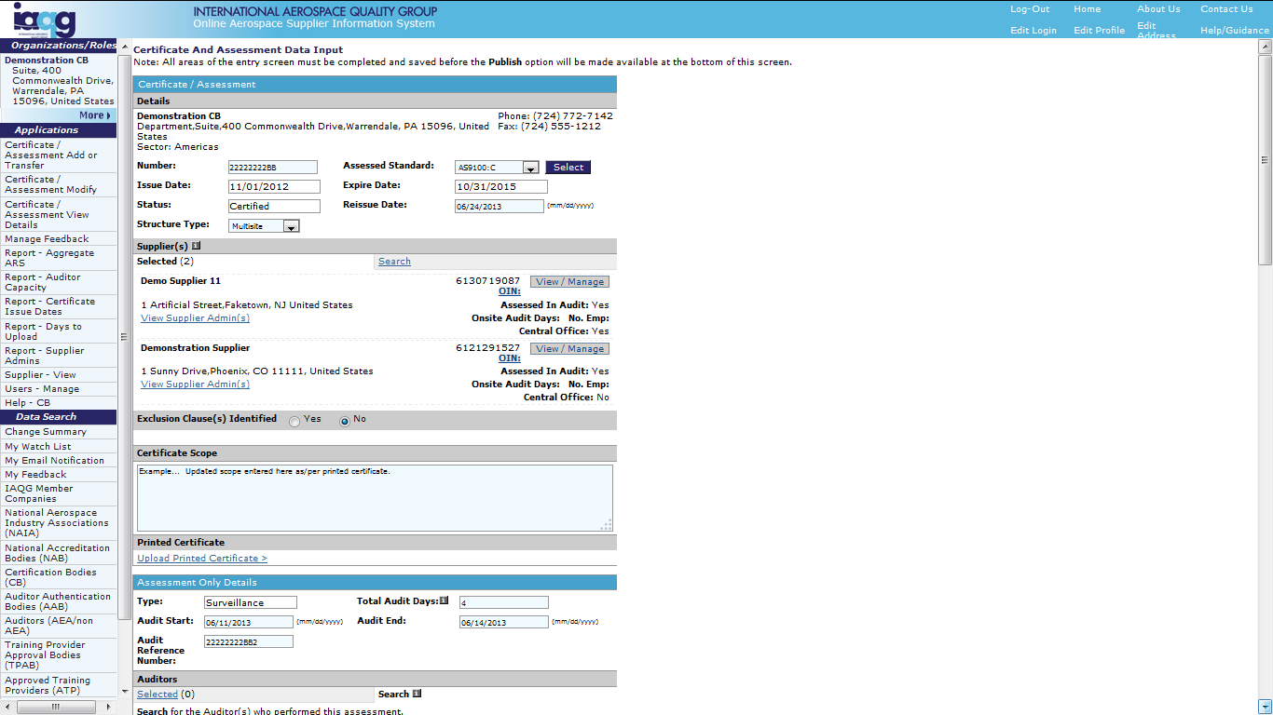
OASIS CB Applications Section
Certificate / Assessment Add: Surveillance Audit Data
When certification data is edited,
enter the certificate’s reissue date
Example scope change.
The revised certificate
must be uploaded

Slide 45
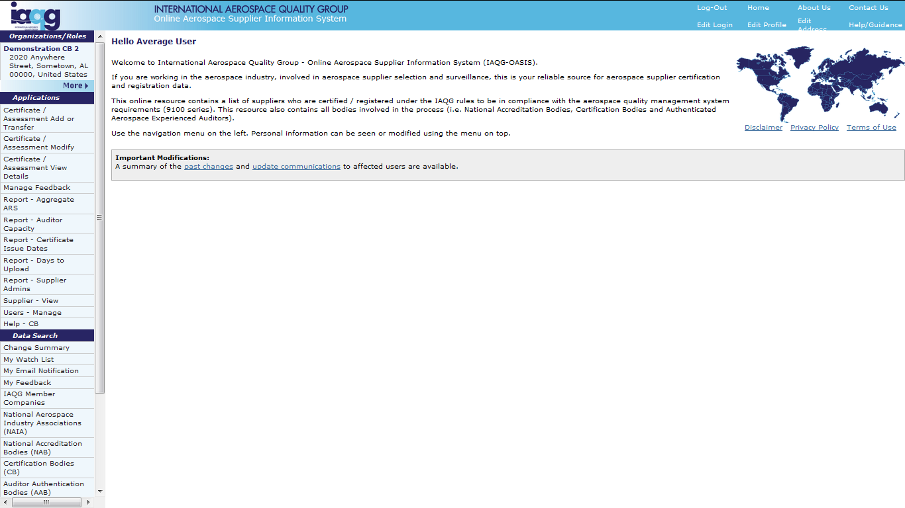
OASIS CB Applications Section
Certificate Transfer
Click to
access
Enables the transfer of certificate(s) from one CB to another

Slide 46
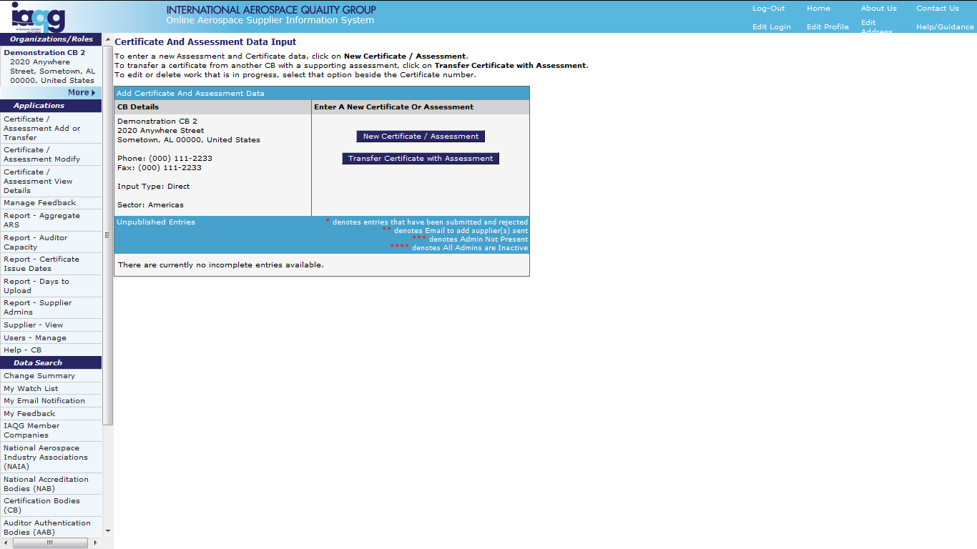
OASIS CB Applications Section
Certificate Transfer
Click to transfer a
certificate(s) to your
CB organization.
Two types of transfers are possible:
  Individual certificate transfers
  Mass transfers resulting from
a CB merger/acquisition

Slide 47
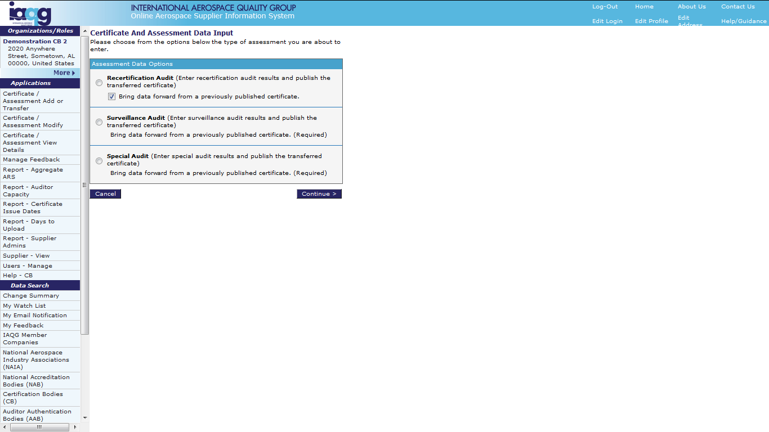
OASIS CB Applications Section
Certificate Transfer: Individual Certificate Transfers
Select the audit type
that was conducted to
support the transfer

Slide 48
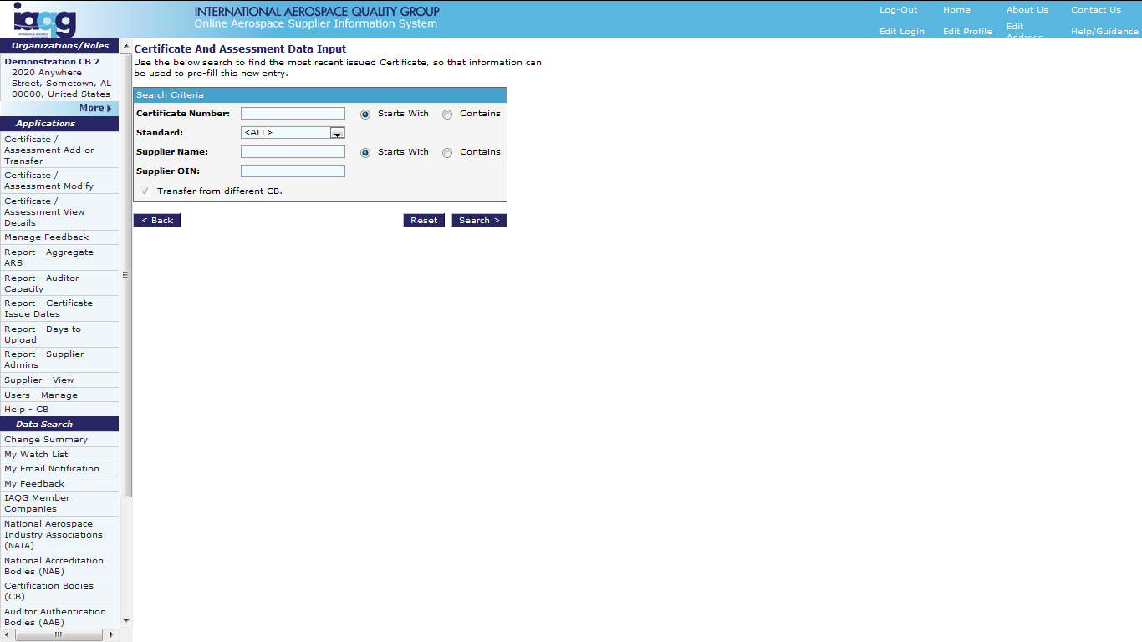
OASIS CB Applications Section
Certificate Transfer: Individual Certificate Transfers
Search for the existing
certificate – published
by a different CB

Slide 49
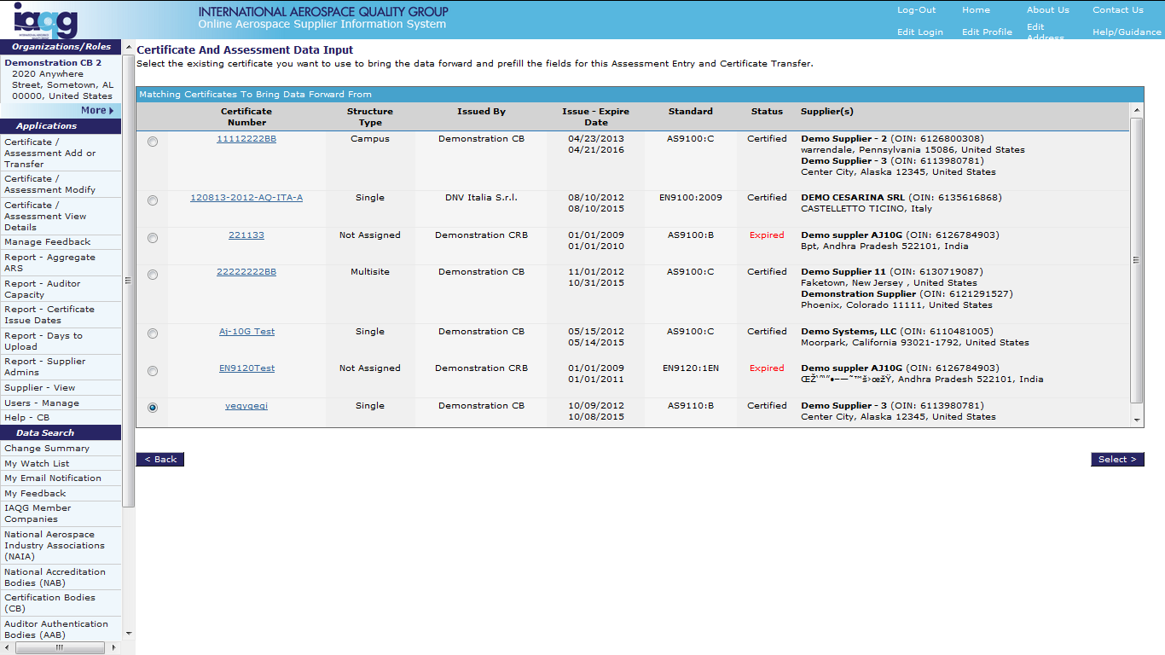
OASIS CB Applications Section
Certificate Transfer: Individual Certificate Transfers
Select the certificate
to be transferred

Slide 50
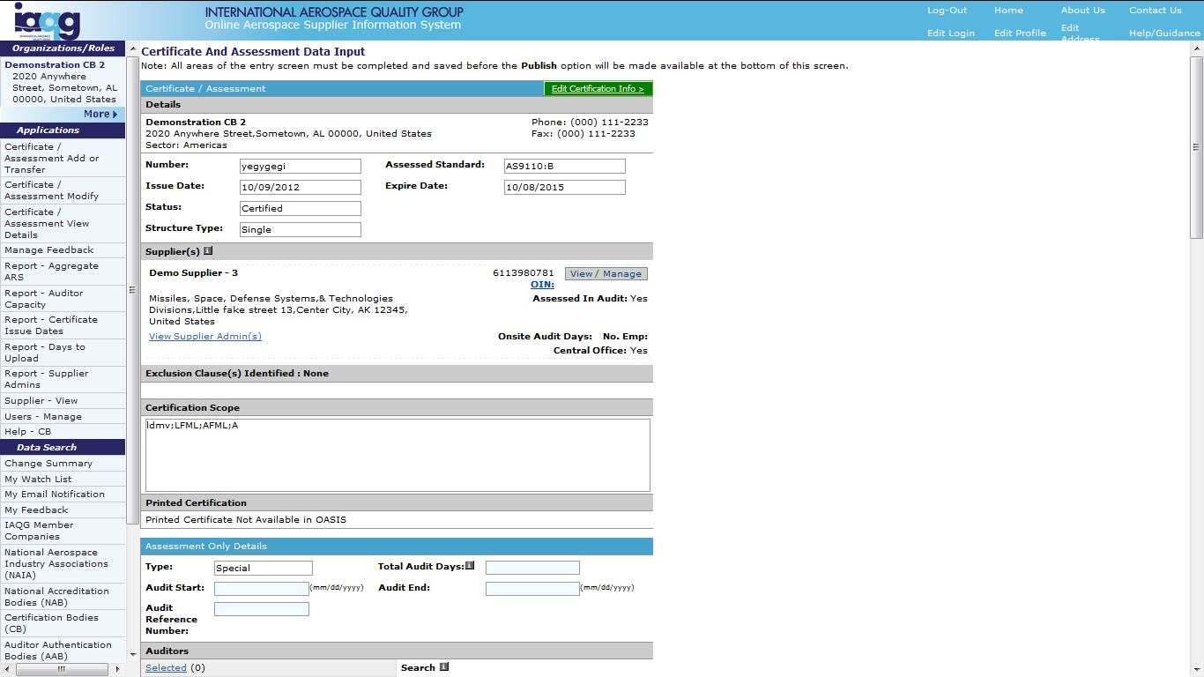
OASIS CB Applications Section
Certificate Transfer: Individual Certificate Transfers
Click the Green button
to edit the certification
data and re-issue
the certificate.

Slide 51
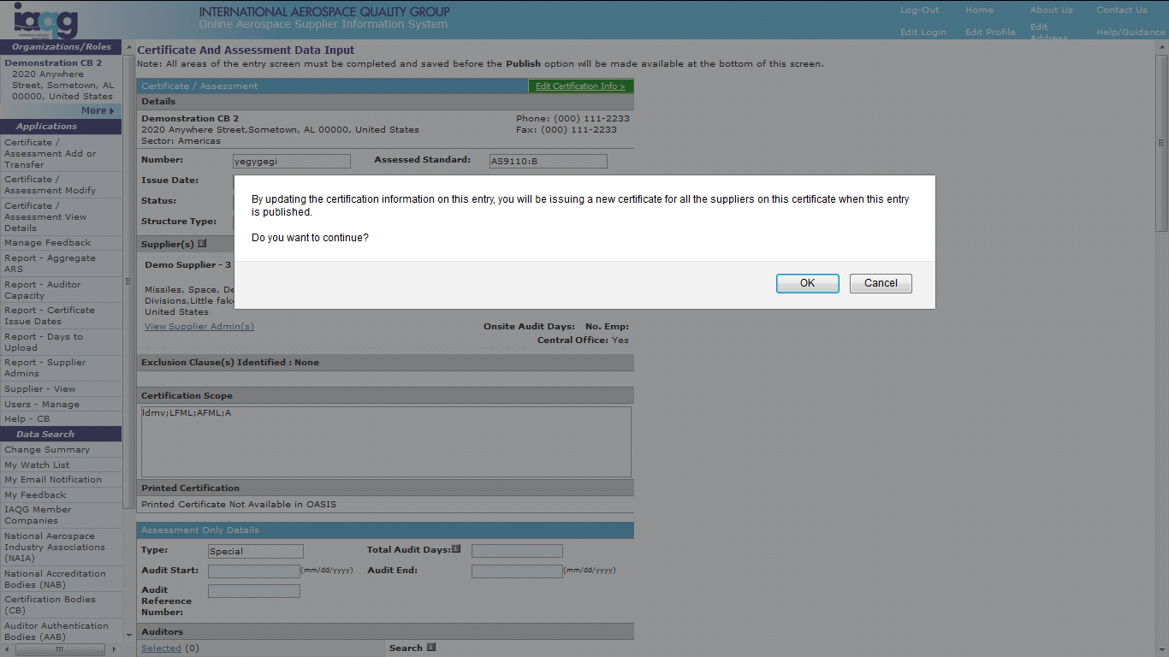
OASIS CB Applications Section
Certificate Transfer: Individual Certificate Transfers
Click “OK” to proceed.

Slide 52
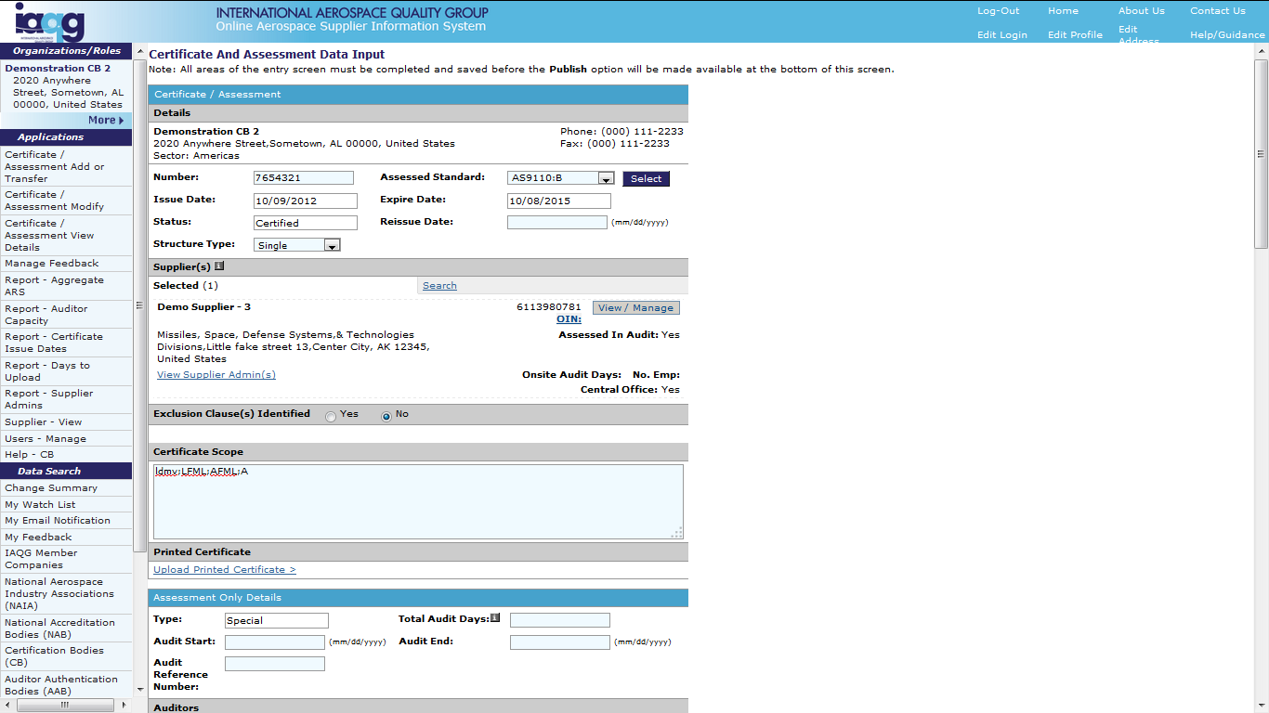
OASIS CB Applications Section
Certificate Transfer: Individual Certificate Transfers
Enter the certificate
reissue date
Enter your CB
certificate number

Slide 53
OASIS CB Applications Section
Certificate Transfer: Individual Certificate Transfers
Select “View/Manage”
to update supplier
information
Verify supplier
administrator
Complete certificate
data entry and upload
new certificate
All other data entry
is the same as for
“Initial Audit Data”

Slide 54
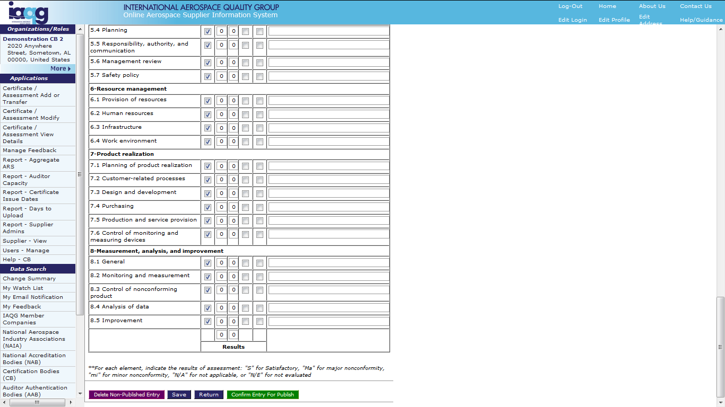
OASIS CB Applications Section
Certificate Transfer: Individual Certificate Transfers
Click to Save
When fully complete,
click the Green button

Slide 55
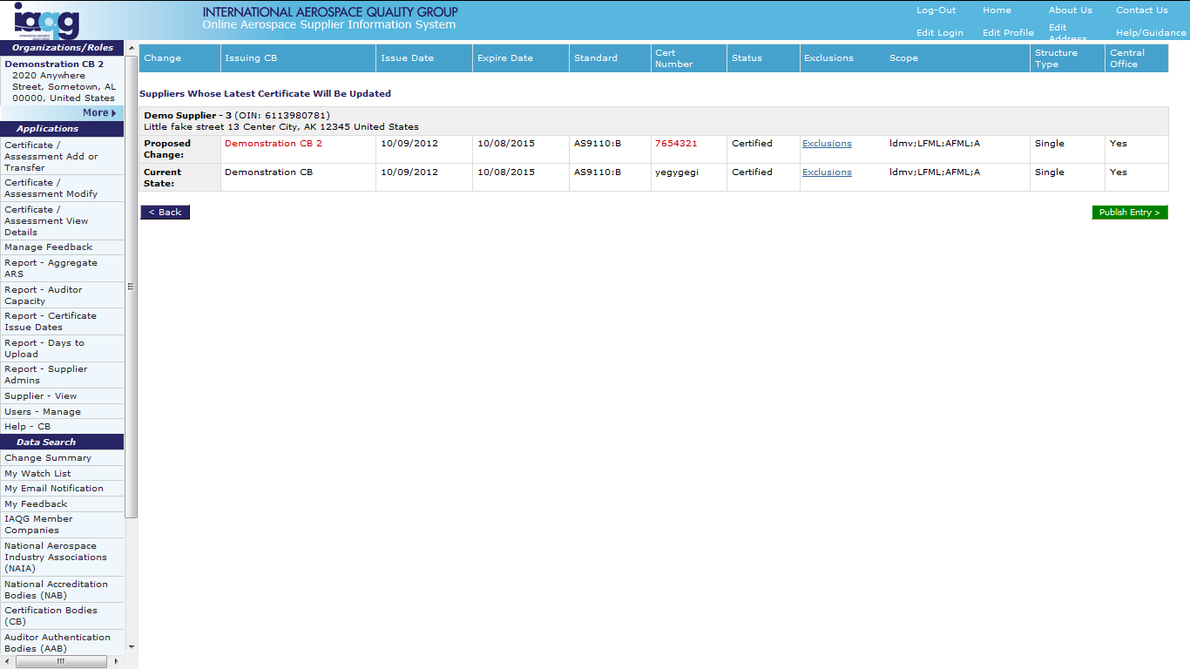
OASIS CB Applications Section
Certificate Transfer: Individual Certificate Transfers
View the
transfer summary
Click to publish
the transfer
Publishing the transfer
will initiate an email
notification to the
previous CB

Slide 56
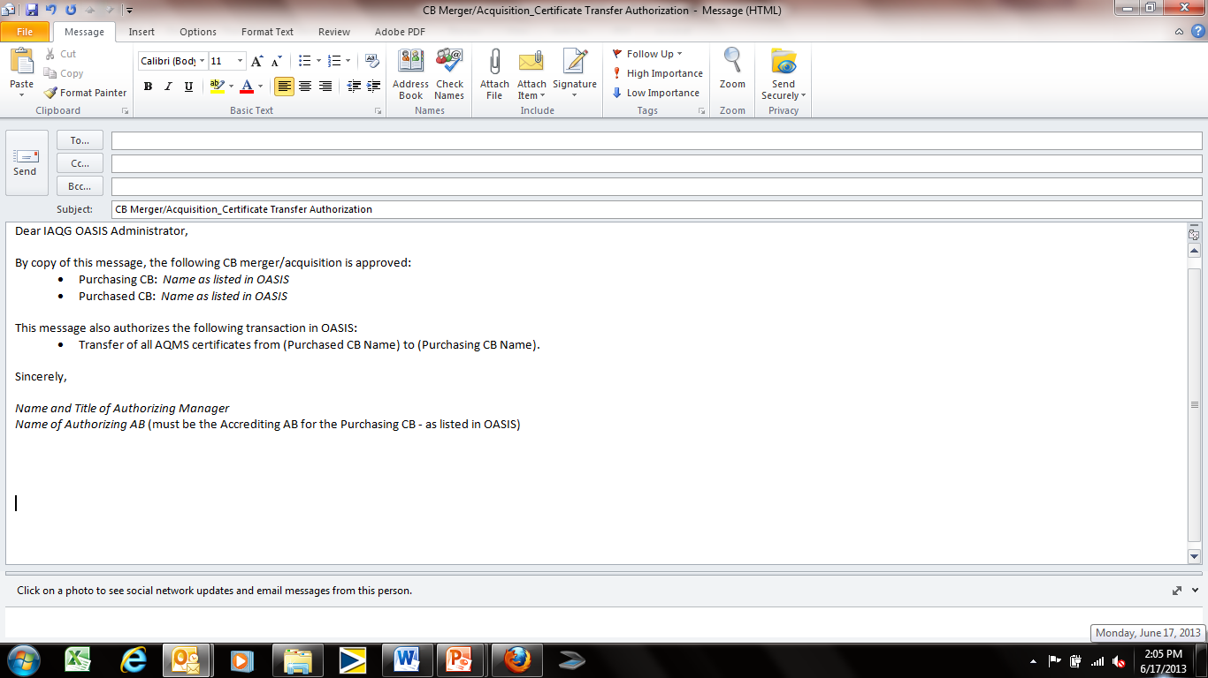
OASIS CB Applications Section
Certificate Transfer: Mass Certificate Transfers
In cases of CB Mergers/Acquisitions, an application is available
in OASIS to enable the mass transfer of certificates from one
(“Purchased”) CB to another (“Purchasing”) CB.
To obtain that application, authorization of the transfer must be
sent to the IAQG OASIS Administrator from the Purchasing CB’s
Accrediting AB.
Note:
Example of
certificate mass
transfer authorization

Slide 57
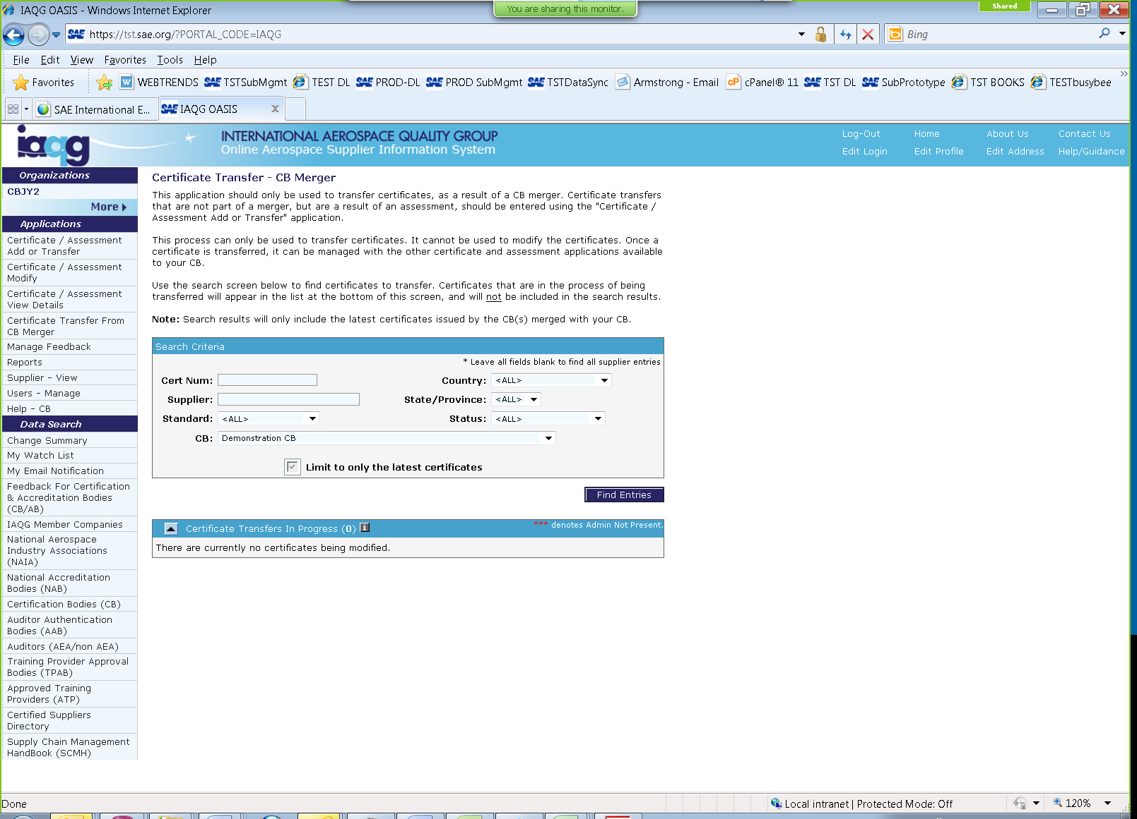
OASIS CB Applications Section
Certificate Transfer: Mass Certificate Transfers
Once authorization has been
provided, the Purchasing CB
will receive an application to
enable completion of the transfer.

Slide 58
OASIS User Training for Certification Bodies
Part 2 – Applications Section
Training Content:
  Overview ✓
  The Main Screen ✓
  Certificate / Assessment Add or Transfer ✓
  Certificate / Assessment Modify
  Certificate / Assessment View Details
  Manage Feedback
  Reports
    Aggregate ARS
    Auditor Capacity
    Certificate Issue Dates
    Days to Upload
    Supplier Admins
  Supplier View
  Users – Manage
  Help - CB

Slide 59
OASIS CB Applications Section
Certificate / Assessment Modify
Modify or Delete?
It is important to understand the difference:
  MODIFY amends the record
  DELETE permanently removes the record from OASIS
ONLY delete an assessment when:
  An entirely incorrect record was entered – one that needs
  to be totally removed.
WARNING! DO NOT DELETE A CERTIFICATION IN ORDER
  TO CHANGE ITS STATUS.
  Doing so will permanently remove the entire OASIS record
  for that certificate.

Slide 60
OASIS CB Applications Section
Certificate / Assessment Modify
When to Delete?
OASIS keeps track of assessment and certificate history
for 6 years.
OASIS automatically removes expired certificates from
the Certified Supplier List, but not from the history.
  DO NOT DELETE expired certifications or assessments!
  When a certificate is withdrawn, use the Certificate Modify
  function to change the certification status to “Withdrawn”
Only delete in cases of incorrect or double record entry!

Slide 61
OASIS CB Applications Section
Certificate / Assessment Modify
When to Modify a Certificate?
Modify a CERTIFICATE for:
  Typing errors
  Change of scope
  Name or address change
    NOTE: A new printed certificate publication requires
    a new upload to OASIS!
  DO NOT USE “MODIFY” when re-certifying a supplier
  (i.e. for a new 3-year period) – the modification will be
  rejected by the Sector OASIS Administrator!
    Instead, use the “Certificate / Assessment Add” function,
    and select “Re-certification”

Slide 62
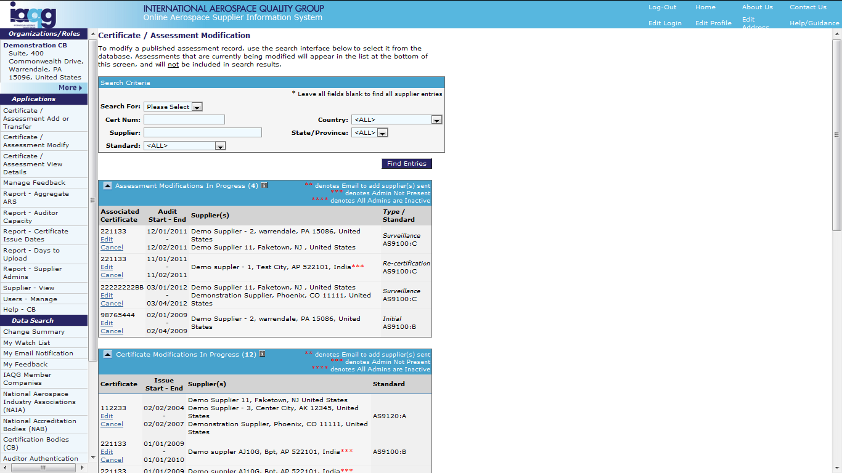
OASIS CB Applications Section
Certificate / Assessment Modify
Enter search parameters.
Search for either:
Assessments or
Certificates
Existing Assessment
modifications in progress:
Select “Edit” to Continue.
“Cancel” deletes modification.
Existing Certificate
modifications in progress:
Select “Edit” to Continue.
“Cancel” deletes modification.

Slide 63
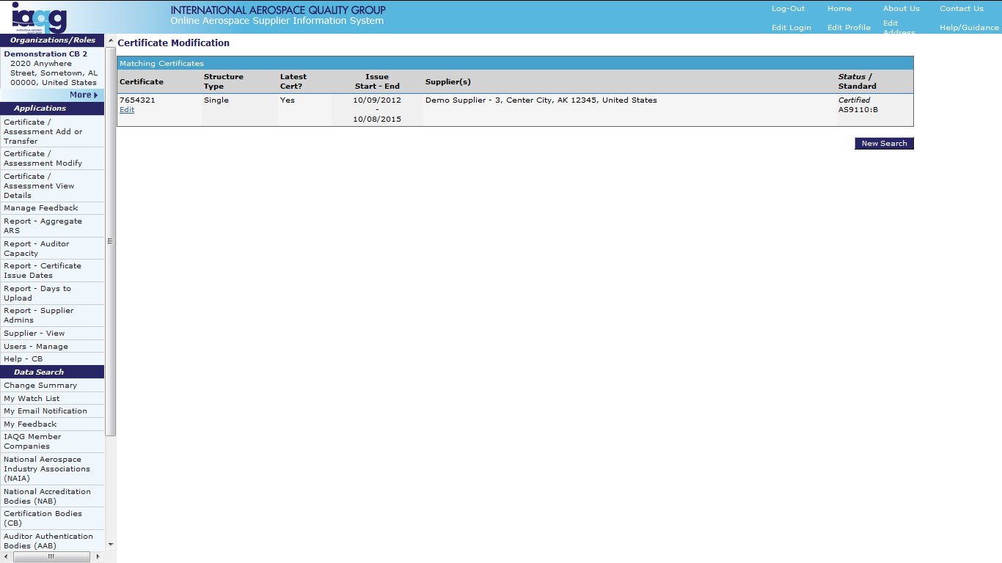
OASIS CB Applications Section
Certificate Modify
Select applicable
certificate and
click “Edit”

Slide 64
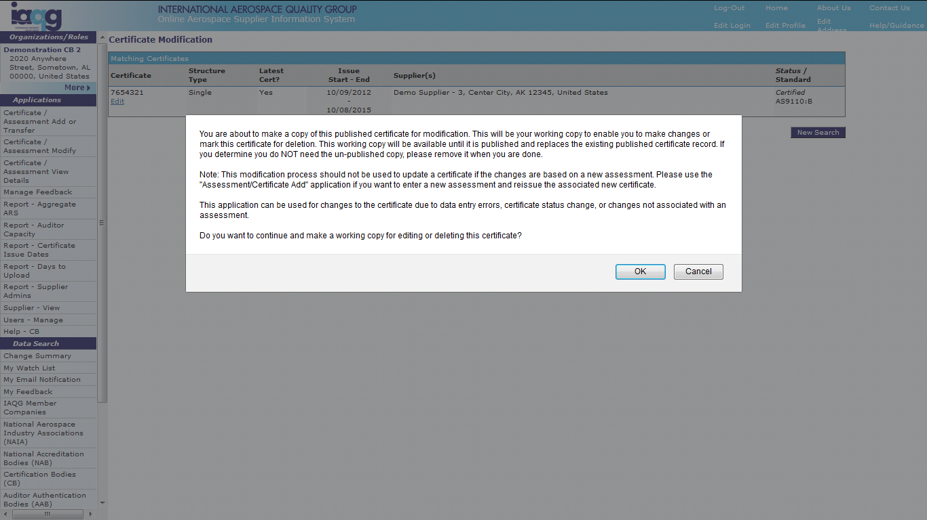
OASIS CB Applications Section
Certificate Modify
Note Warning! Click
“OK” to proceed.

Slide 65
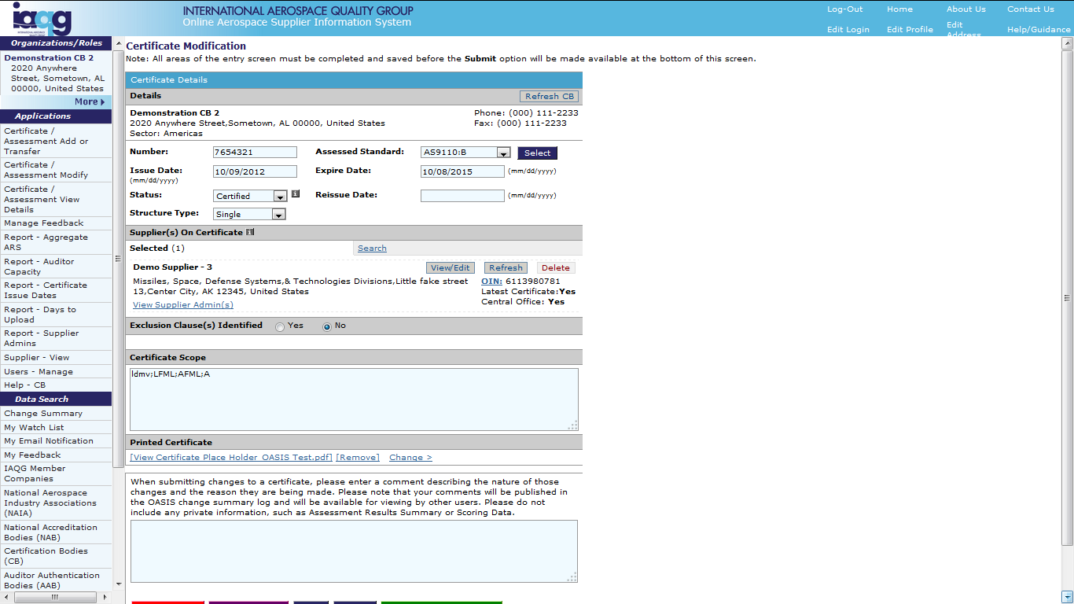
OASIS CB Applications Section
Certificate Modify
Always enter reissue date:
Same as on certificate
Between Issue and
Expire dates
Change Certification status
using drop down. Select:
Certified
Suspended or
Withdrawn

Slide 66
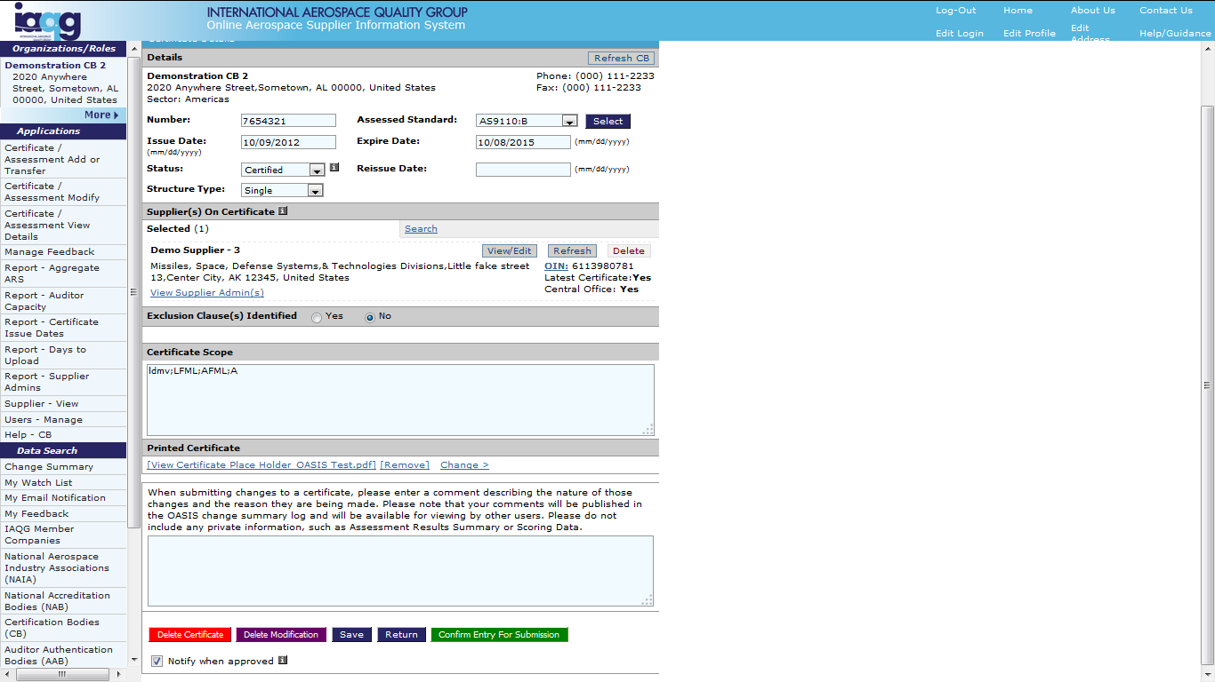
OASIS CB Applications Section
Certificate Modify
Always add an explanation
for the change:
- Change due to…
DO NOT just enter
“Certificate modified”

Slide 67
OASIS CB Applications Section
Certificate Modify
5 Options:
Delete Certificate
Delete Modification
Save
Return
Confirm Entry for Submission

Slide 68
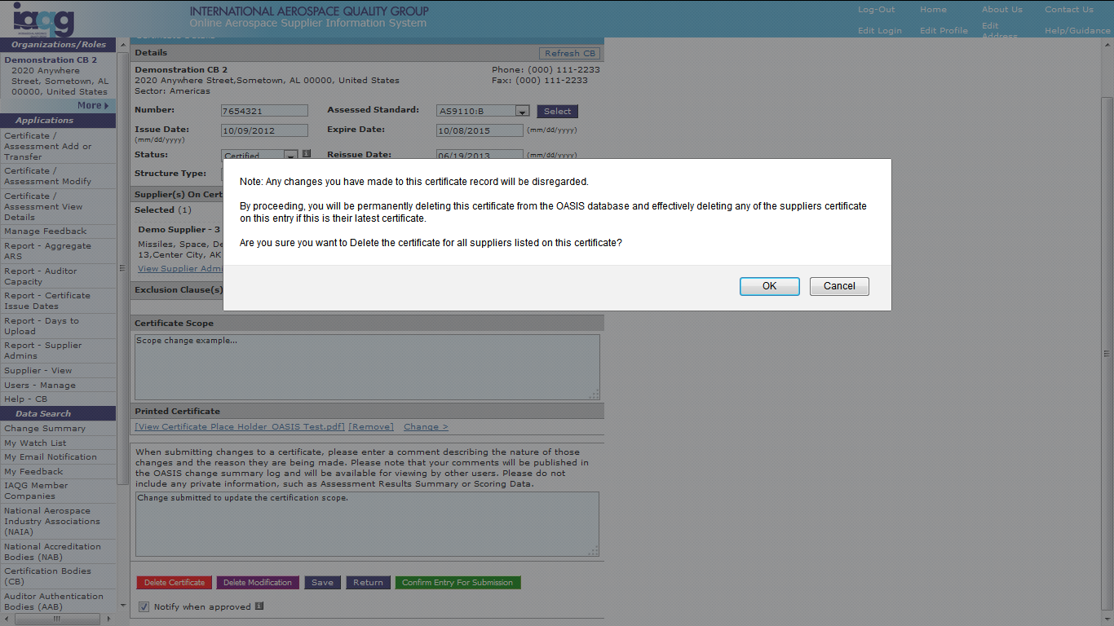
OASIS CB Applications Section
Certificate Modify
If “Delete Certificate” is selected,
a WARNING will appear.
Only “Delete Certificate” for
double certification entry or
completely incorrect record!
Deletion removes the entire
certificate history.

Slide 69
OASIS CB Applications Section
Certificate Modify
Modification Choices:
Delete Certificate
  Only use in case of duplicate or entirely incorrect record as
  deletion will remove the entire certificate history.
Delete Modification
  Applies to in-process modifications that are being temporarily
  stored in the “Work” area.
Save
  Save changes in the work area for further processing.
Return
  Go back to the Certificate/Assessment Modification Screen
Confirm Entry for Submission
  Send the modification to the OASIS Sector Administrator for approval

Slide 70
OASIS CB Applications Section
Certificate Modify
Expired Certificates:
Do not cancel or delete an expired certificate!
  OASIS will do this automatically. The visible certificate status
  will then be shown as “Expired.”
  After 13 weeks, an “Expired” certificate will no longer be publicly
  visible in OASIS, although the data will still remain in the database.
Only Modify a certificate to “Withdrawn” status when a supplier
no longer fulfills AQMS requirements.
  If a supplier transfers to another Certification Body, simply allow
  your certificate to expire. The OASIS Change Summary and the
  Certified Suppliers Directory will show the latest issuing CB.

Slide 71
OASIS User Training for Certification Bodies
Part 2 – Applications Section
Training Content:
  Overview ✓
  The Main Screen ✓
  Certificate / Assessment Add or Transfer ✓
  Certificate / Assessment Modify ✓
  Certificate / Assessment View Details
  Manage Feedback
  Reports
    Aggregate ARS
    Auditor Capacity
    Certificate Issue Dates
    Days to Upload
    Supplier Admins
  Supplier View
  Users – Manage
  Help - CB

Slide 72
OASIS CB Applications Section
Certificate / Assessment View Details
Click to
access
Shows certificate and audit data already entered by your CB

Slide 73
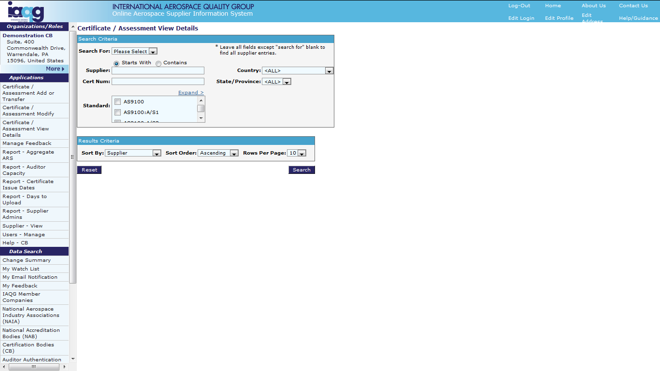
OASIS CB Applications Section
Certificate / Assessment View Details
From drop down,
select Certificates or
Assessments
Enter search parameters
and click “Search”

Slide 74
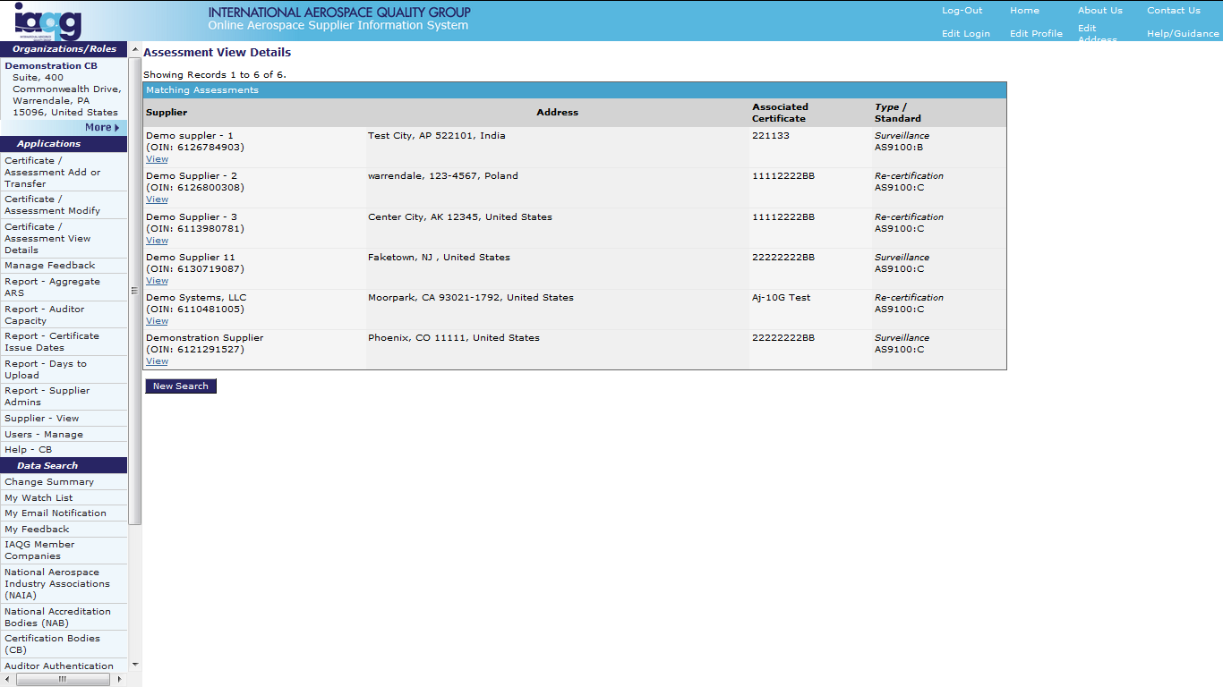
OASIS CB Applications Section
Certificate View Details
Identify supplier and
then click “View”

Slide 75
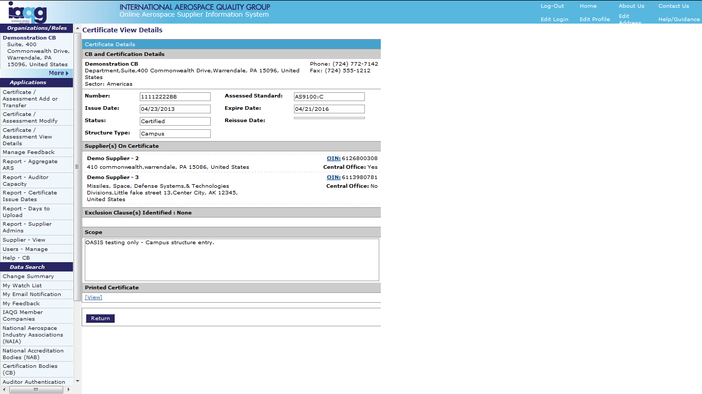
OASIS CB Applications Section
Certificate View Details
Shows details from the
selected assessment
Click “View” to see the
uploaded Certificate

Slide 76
OASIS CB Applications Section
Assessment View Details
Identify supplier and
then click “View”

Slide 77

OASIS CB Applications Section
Assessment View Details
Shows the assessment
being viewed
Shows details from the
selected assessment

Slide 78
OASIS User Training for Certification Bodies
Part 2 – Applications Section
Training Content:
  Overview ✓
  The Main Screen ✓
  Certificate / Assessment Add or Transfer ✓
  Certificate / Assessment Modify ✓
  Certificate / Assessment View Details ✓
  Manage Feedback
  Reports
    Aggregate ARS
    Auditor Capacity
    Certificate Issue Dates
    Days to Upload
    Supplier Admins
  Supplier View
  Users – Manage
  Help - CB

Slide 79

OASIS CB Applications Section
Manage Feedback – General Information
Feedback requests (tickets) may be created by any registered
OASIS user.
There are two paths by which users can create feedback requests.
Options differ depending on the path chosen.

Slide 80
OASIS CB Applications Section
Manage Feedback – General Information
Read all feedback requests. Always respond when requested to.
Respond as soon as possible.
The requestor will see all responses submitted.
The requestor may delegate to the recipient the ability to close
the request.
The requestor may re-open a request if they believe it was in fact
not closed.

Slide 81
OASIS CB Applications Section
Manage Feedback
Click to
access
Allows management of feedback requests that have been sent to your CB organization

Slide 82

OASIS CB Applications Section
Manage Feedback
Click to select a
recipient type and send
a new feedback ticket
Filtering options
for viewing the list of
feedback requests
Click on the entry to
process the request.
Note: Each feedback
request has a unique
reference number.
Click to download
the list to Excel

Slide 83

OASIS CB Applications Section
Manage Feedback
Click to invite, view
or manage contributors
to the feedback discussion
View details of the
request and any
attachments that
were included
Click to add a response
if one is requested

Slide 84

OASIS CB Applications Section
Manage Feedback
If a response was requested,
select the type using
the drop down menu
Check to copy the response
to associates in your
organization who have
access to feedback entries.
Add message and
attach any applicable files
Click to send response

Slide 85
OASIS User Training for Certification Bodies
Part 2 – Applications Section
Training Content:
  Overview ✓
  The Main Screen ✓
  Certificate / Assessment Add or Transfer ✓
  Certificate / Assessment Modify ✓
  Certificate / Assessment View Details ✓
  Manage Feedback ✓
  Reports
    Aggregate ARS
    Auditor Capacity
    Certificate Issue Dates
    Days to Upload
    Supplier Admins
  Supplier View
  Users – Manage
  Help - CB

Slide 86

OASIS CB Applications Section
Reports
Several reports are currently available to CB’s
    Aggregate ARS
    Auditor Capacity
    Certificate Issue Dates
    Days to Upload
    Supplier Admins
CB Reports

Slide 87

OASIS CB Applications Section
Report: Aggregate ARS
Select report parameters
including one or more
Family of Standards.
Then click
“Get Report”

Slide 88

OASIS CB Applications Section
Report: Aggregate ARS
Screen indicating that
the report is being
generated.

Slide 89

OASIS CB Applications Section
Report: Aggregate ARS
Shows the average number
of nonconformities reported
by AQMS clause and audit type:
Initial
Recertification
Surveillance
Special
All
Allows comparison by:
AEA’s (AEA-led teams)
at your CB
Others within your Sector
Others Globally

Slide 90

OASIS CB Applications Section
Report: Auditor Capacity
Enter time period
for report
Click to
get report

Slide 91

OASIS CB Applications Section
Report: Auditor Capacity
Provides an indication of
auditor utilization by your
CB within the timeframe
selected
Calculates AEA and AA days
based on the number of
auditors and total audit days
entered into OASIS

Slide 92

OASIS CB Applications Section
Report: Certificate Issue Dates
Enter time period
for report
Click to
get report

Slide 93


OASIS CB Applications Section
Report: Certificate Issue Dates
Shows certificate issue/re-issue
dates, and the number of days (gap)
between a cert’s previous expiration
date and the date it was re-issued.
A positive (+) number gap
indicates that the certificate
was re-issued after its
previous expiration date.

Slide 94

OASIS CB Applications Section
Report: Days to Upload
Enter time period
for report
Click to
get report

Slide 95


OASIS CB Applications Section
Report: Days to Upload
Shows the number of days
between audit completion and
audit data upload into OASIS
Indicates whether time taken
to upload audit data complies
with applicable standards

Slide 96

OASIS CB Applications Section
Report: Supplier Admins
Click to
get report

Slide 97


OASIS CB Applications Section
Report: Supplier Admins
For suppliers having an assessment
entered by your CB:
Shows active OASIS Administrators
Shows cases in which no active
OASIS Administrator is present

Slide 98
OASIS User Training for Certification Bodies
Part 2 – Applications Section
Training Content:
  Overview ✓
  The Main Screen ✓
  Certificate / Assessment Add or Transfer ✓
  Certificate / Assessment Modify ✓
  Certificate / Assessment View Details ✓
  Manage Feedback ✓
  Reports ✓
    Aggregate ARS
    Auditor Capacity
    Certificate Issue Dates
    Days to Upload
    Supplier Admins
  Supplier View
  Users – Manage
  Help - CB

Slide 99
OASIS CB Applications Section
Supplier - View
Click to
access
Shows organizational contact information entered by suppliers for each certificated site

Slide 100

OASIS CB Applications Section
Supplier - View
Enter organization name
and then click “Search”

Slide 101

OASIS CB Applications Section
Supplier - View
Select supplier
Click to view data

Slide 102

OASIS CB Applications Section
Supplier - View
Latest supplier
contact information
Click to go directly to
“Certificate/Assessment
to enter a new assessment
for this supplier
Click to view the supplier’s
OASIS Administrator

Slide 103
OASIS User Training for Certification Bodies
Part 2 – Applications Section
Training Content:
  Overview ✓
  The Main Screen ✓
  Certificate / Assessment Add or Transfer ✓
  Certificate / Assessment Modify ✓
  Certificate / Assessment View Details ✓
  Manage Feedback ✓
  Reports ✓
    Aggregate ARS
    Auditor Capacity
    Certificate Issue Dates
    Days to Upload
    Supplier Admins
  Supplier View ✓
  Users – Manage
  Help - CB

Slide 104
OASIS CB Applications Section
Users - Manage
Click to
access
Allows:
Adding, editing or removing OASIS users within your CB organization
Managing application privileges for those users

Slide 105

OASIS CB Applications Section
Users - Manage
Search to add users
already registered
in OASIS
Click to register
a new user
Click to edit
an existing user

Slide 106

OASIS CB Applications Section
Users - Manage
User details
Un-check to “de-activate”
user from your
OASIS applications
Enter start/end dates for
access to privileges. Leaving
blank indicates no end date.

Slide 107
OASIS CB Applications Section
Users - Manage
Check/un-check to
add or remove individual
application privileges
NOTE: Associates with “Users-Manage”
privileges are considered “OASIS
Administrators.” It is recommended
that there is only one user with this
privilege at each CB organization.
Click to save info

Slide 108
OASIS User Training for Certification Bodies
Part 2 – Applications Section
Training Content:
  Overview ✓
  The Main Screen ✓
  Certificate / Assessment Add or Transfer ✓
  Certificate / Assessment Modify ✓
  Certificate / Assessment View Details ✓
  Manage Feedback ✓
  Reports ✓
    Aggregate ARS
    Auditor Capacity
    Certificate Issue Dates
    Days to Upload
    Supplier Admins
  Supplier View ✓
  Users – Manage ✓
  Help - CB

Slide 109
OASIS CB Applications Section
Help - CB
Click to
access

Slide 110

OASIS CB Applications Section
Help - CB
Click to provide feedback
regarding the Help-CB section
Click topic to review

Slide 111
OASIS User Training for Certification Bodies
Part 2 – Applications Section
Training Content:
  Overview ✓
  The Main Screen ✓
  Certificate / Assessment Add or Transfer ✓
  Certificate / Assessment Modify ✓
  Certificate / Assessment View Details ✓
  Manage Feedback ✓
  Reports ✓
    Aggregate ARS
    Auditor Capacity
    Certificate Issue Dates
    Days to Upload
    Supplier Admins
  Supplier View ✓
  Users – Manage ✓
  Help – CB ✓

Slide 112

OASIS CB Applications Section

